Slide 1
Merced City Council Redistricting Draft Maps
Dr. Jeff Tilton, Senior Consultant
National Demographics Corporation

Slide 2
Redistricting Process
Step | Description
City Council Public Hearing June 21, 2021 | Held prior to release of draft maps Educate, solicit input on the communities in the Districts
Census Data Releases | Census Bureau releases official 2020 Census population data – August 12 California’s official ‘prisoner-adjusted’ 2020 redistricting data – Sept. 20, 27
RAC Public Hearing September 15, 2021 | Held prior to release of draft maps Educate, solicit input on the communities in the Districts
Public Workshop November 6, 2021 | Gather data on communities of interest, neighborhoods Learn more about the public mapping tools
RAC Public Hearing December 1, 2021 | Held prior to release of draft maps Educate, solicit input on the communities in the Districts
Public Workshop January 12, 2022 | Gather data on communities of interest, neighborhoods
RAC Public Hearing January 22, 2022 | Review neighborhoods/communities of interest Discuss and recommend up to two (2) draft maps (Nos. 107, 203)
City Council Public Hearing February 7, 2022 | Discuss, revise draft maps; discuss election sequencing
City Council Public Hearing March 7, 2022 | Discuss, determine final map

Slide 3
Redistricting Rules and Goals
Federal Laws
California Criteria
For Cities
Equal Population
Federal Voting Rights Act
No Racial Gerrymandering
Geographically contiguous
Undivided neighborhoods and “communities of interest”
Easily identifiable boundaries
Compact
Prohibited: “Shall not favor or discriminate against a political party.”

Slide 4
City of Merced - 2015 Adopted Plan
District |  | 1 | 2 | 3 | 4 | 5 | 6 | City
 | Total Pop | 13,236 | 13,332 | 12,728 | 12,579 | 13,700 | 13,267 | 78,842
2010 Census | Deviation from ideal | 96 | 192 | -412 | -561 | 560 | 127 | 1,121
 | % Deviation | 0.73% | 1.46% | -3.14% | -4.27% | 4.26% | 0.97% | 8.53%
Total Pop | % Hisp | 59% | 76% | 52% | 38% | 40% | 33% | 50%
 | % NH White | 20% | 5% | 32% | 45% | 35% | 42% | 30%
 | % NH Black | 6% | 5% | 6% | 5% | 10% | 5% | 6%
 | % Asian-American | 14% | 13% | 7% | 8% | 13% | 18% | 12%
Citizen Voting Age Pop | % Hisp | 47% | 59% | 36% | 27% | 35% | 28% | 37%
 | % NH White | 32% | 9% | 46% | 57% | 47% | 49% | 43%
 | % NH Black | 7% | 9% | 6% | 6% | 7% | 7% | 7%
 | % Asian-American | 12% | 21% | 6% | 6% | 8% | 15% | 11%
Ideal population per District: 13,140

Slide 5
City of Merced - 2020 Census
Category | Field | 1 | 2 | 3 | 4 | 5 | 6 | Total
2020 Census | Total Population | 15,145 | 13,783 | 12,762 | 14,039 | 14,211 | 16,741 | 86,681
 | Population Dev. | 698 | -664 | -1,685 | -408 | -236 | 2,294 | 3,979
 | Pct. Deviation | 4.83% | -4.60% | -11.66% | -2.82% | -1.63% | 15.88% | 27.54%
Total Pop. | Hispanic/Latino | 66% | 81% | 59% | 46% | 49% | 40% | 56%
 | NH White | 14% | 6% | 24% | 36% | 28% | 32% | 24%
 | NH Black | 5% | 4% | 6% | 5% | 7% | 6% | 6%
 | NH Asian/Pac.Isl. | 12% | 8% | 8% | 10% | 14% | 20% | 12%
 | NH Native Amer. | 1% | 1% | 2% | 2% | 1% | 1% | 1%
Citizen Voting Age Pop | Total | 6,064 | 5,206 | 7,763 | 8,925 | 10,085 | 10,010 | 48,053
 | Hisp | 51% | 62% | 50% | 39% | 39% | 42% | 45%
 | NH White | 27% | 14% | 37% | 46% | 35% | 37% | 34%
 | NH Black | 8% | 8% | 6% | 7% | 11% | 5% | 7%
 | Asian/Pac.Isl. | 15% | 16% | 7% | 8% | 14% | 16% | 13%
 | Native Amer. | 1% | 1% | 2% | 0% | 1% | 1% | 1%
Ideal population per District: 14,447

Slide 6
Neighborhoods/Communities of Interest
Neighborhoods
What is your neighborhood?
What are its geographic boundaries?
In the absence of public testimony, planning records and other similar documents may provide definition.
Communities of Interest
What defines your community?
Would this community benefit from being “included within a single district for purposes of its effective and fair representation”?
Communities of Interest may not include relationships with political parties, incumbents, or political candidates.

Slide 7
Possible Neighborhoods / Communities
Airport area Applegate Park Bear Creek as a midline Campus Parkway area City schools (“civic centers”) Communities north of Yosemite Parkway – the “bird streets” Courthouse Park Cruickshank, Chenoweth, Burbank, Peterson schools Downtown -- BNSF up to Bear Creek (natural North boundary of D3); Highway 99 and Bear Creek (south boundary) | Downtown Merced area Downtown Neighborhood Association – Main, 18th, 19th Elementary school attendance boundaries Givens, Charles Wright schools Golden Valley Neighborhood Association – south of Golden Valley High School Greenbriar Historic downtown association Intact downtown Loughborough
Submissions edited for clarity and brevity

Slide 8
Possible Neighborhoods / Communities
Main Street Association Merced College – “college streets” Merced College area Merced Mall area Muir Wood North Merced (schools, Merced College) North/South boundary at Bear Creek Old Town Ragsdale community -- G street, Bear Creek, Santa Fe, Glenn Regional Parks | South Merced surrounding churches South Merced, circle around Tenaya South Merced, South Merced Coalition -- African American church locations South of Bear Creek, end of Bear Creek, old family residences, down to 18th Street, R Street-Highway 59 South of Childs/east of Parsons, new housing last 15 years Spaghetti Acres University area
Submissions edited for clarity and brevity

Slide 9
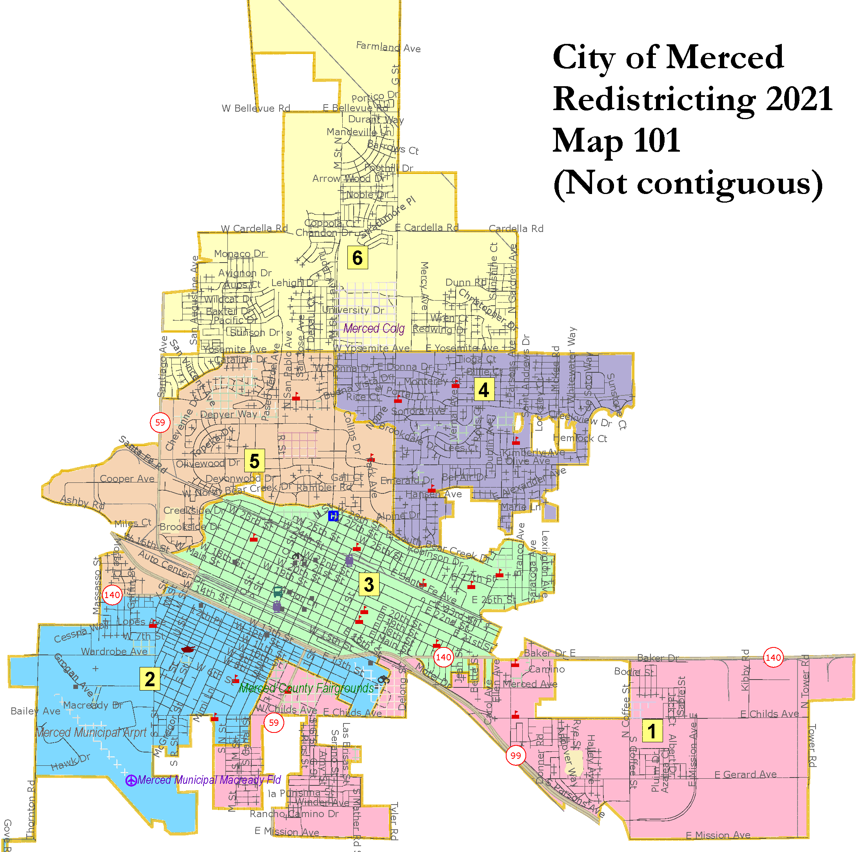
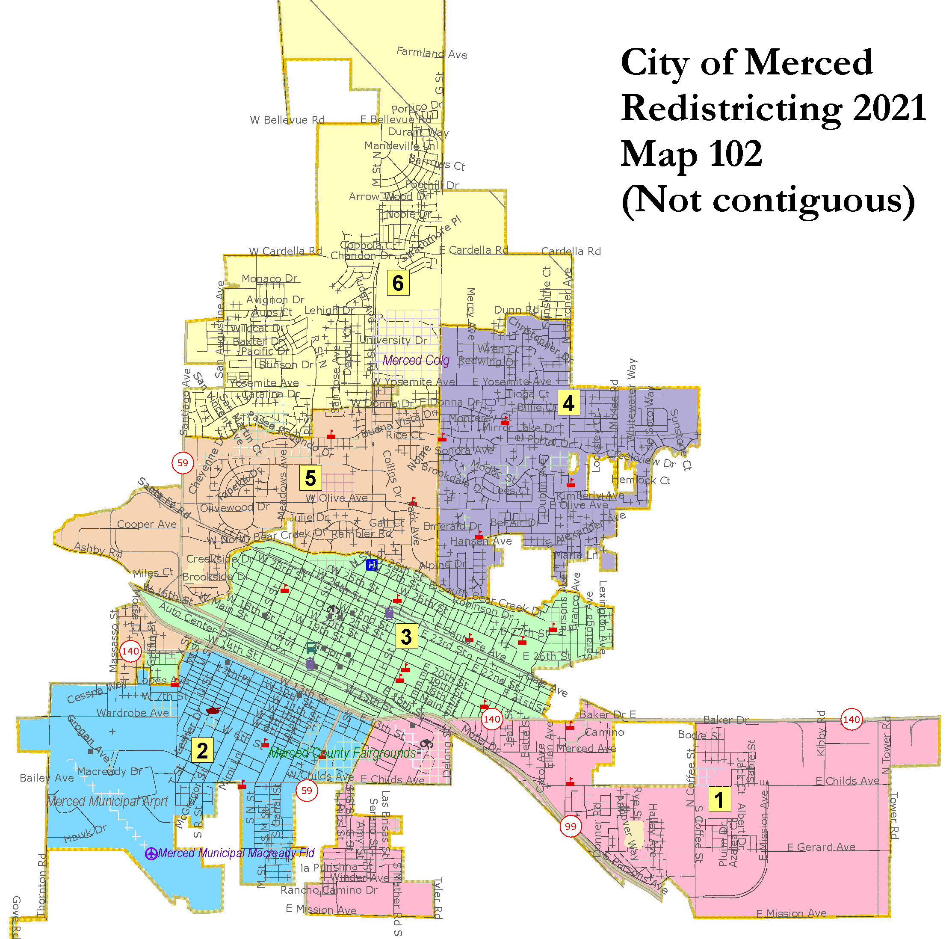
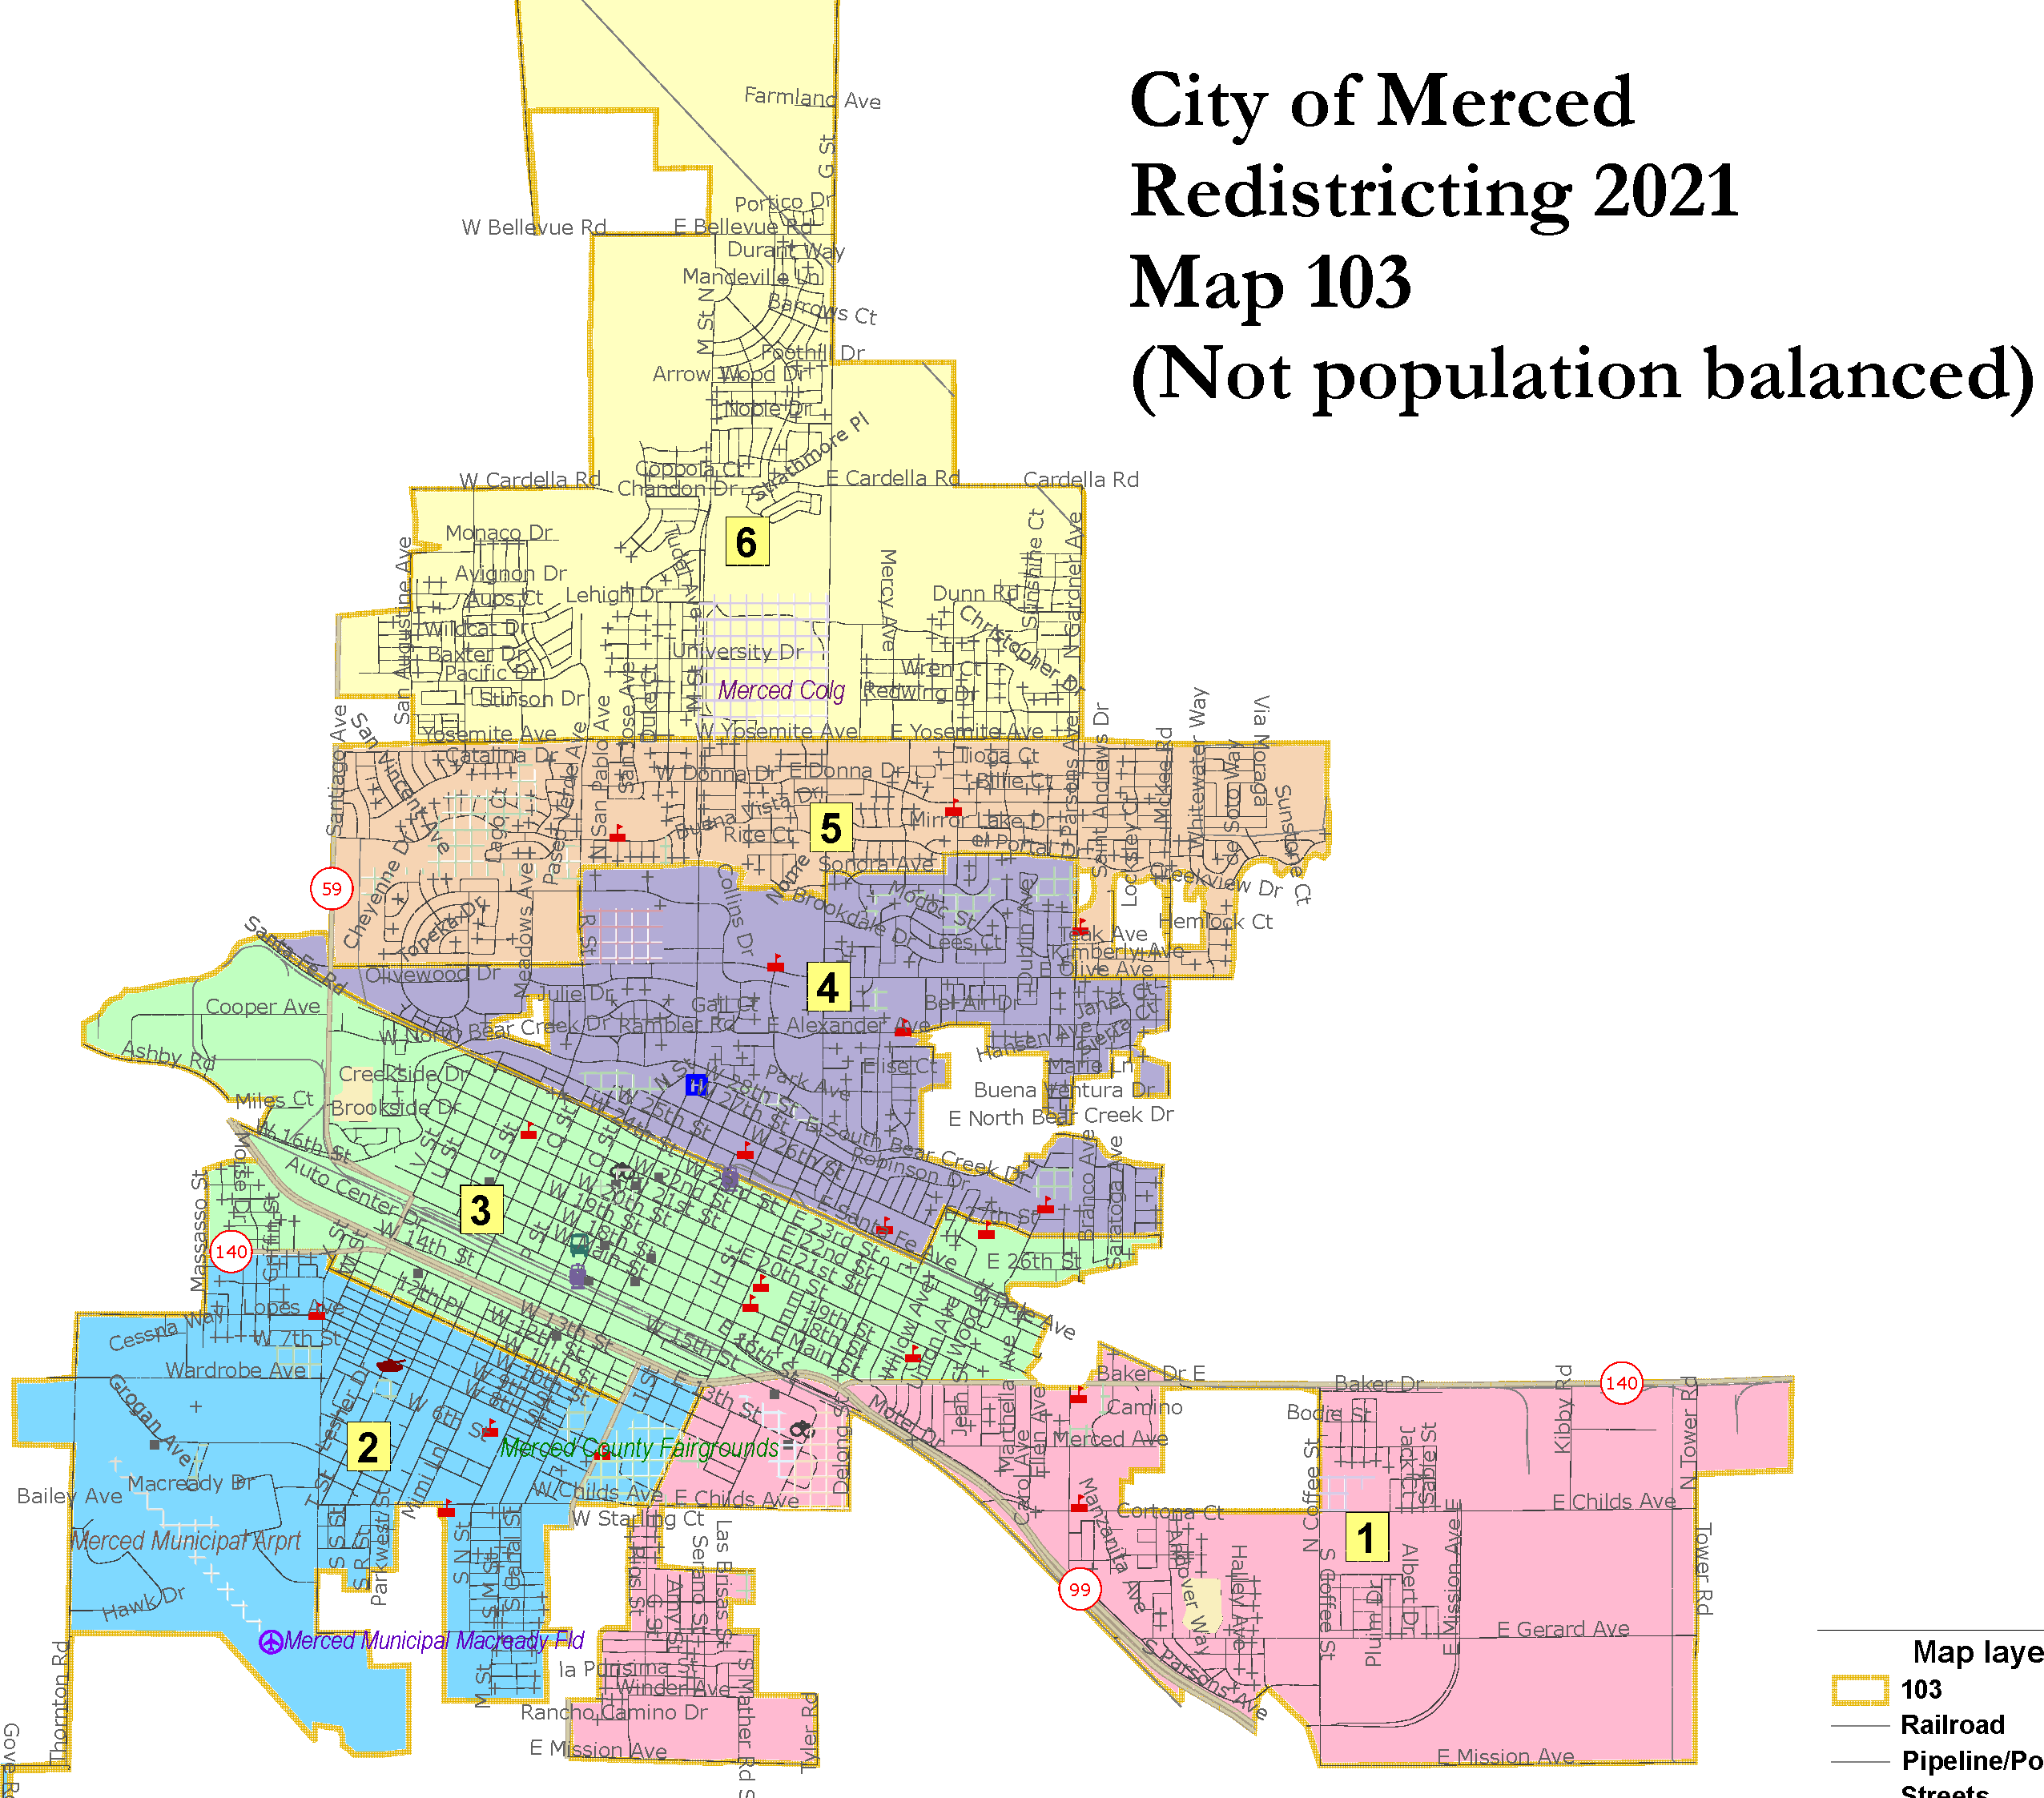
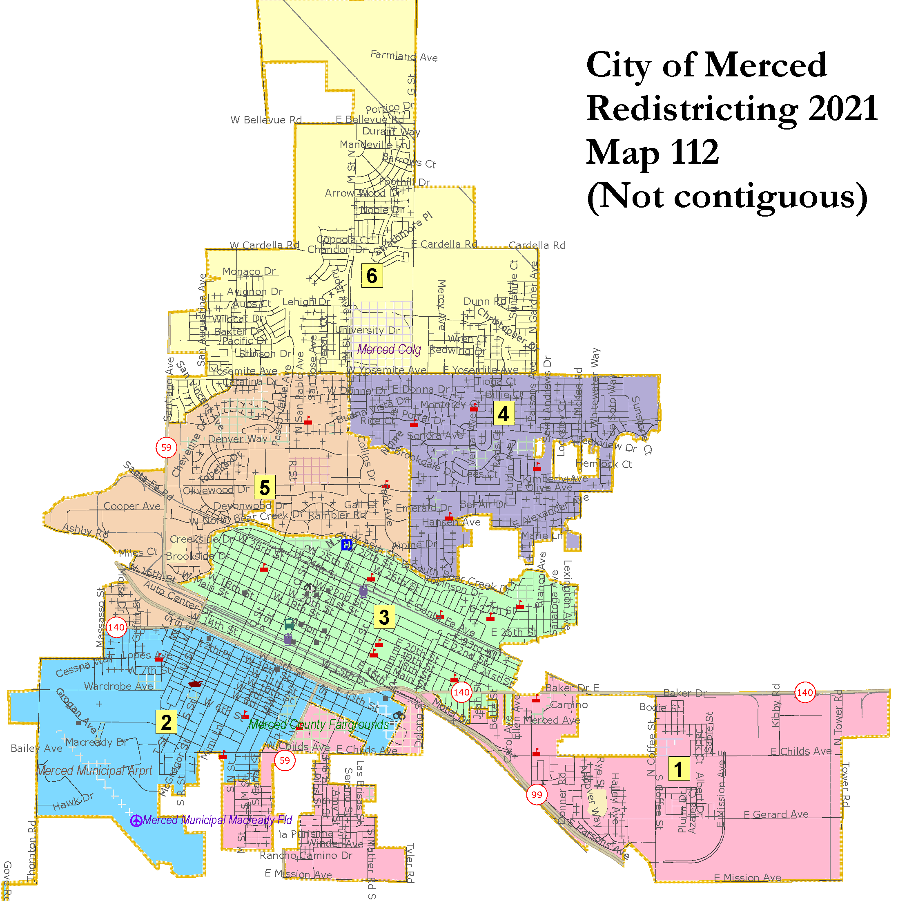
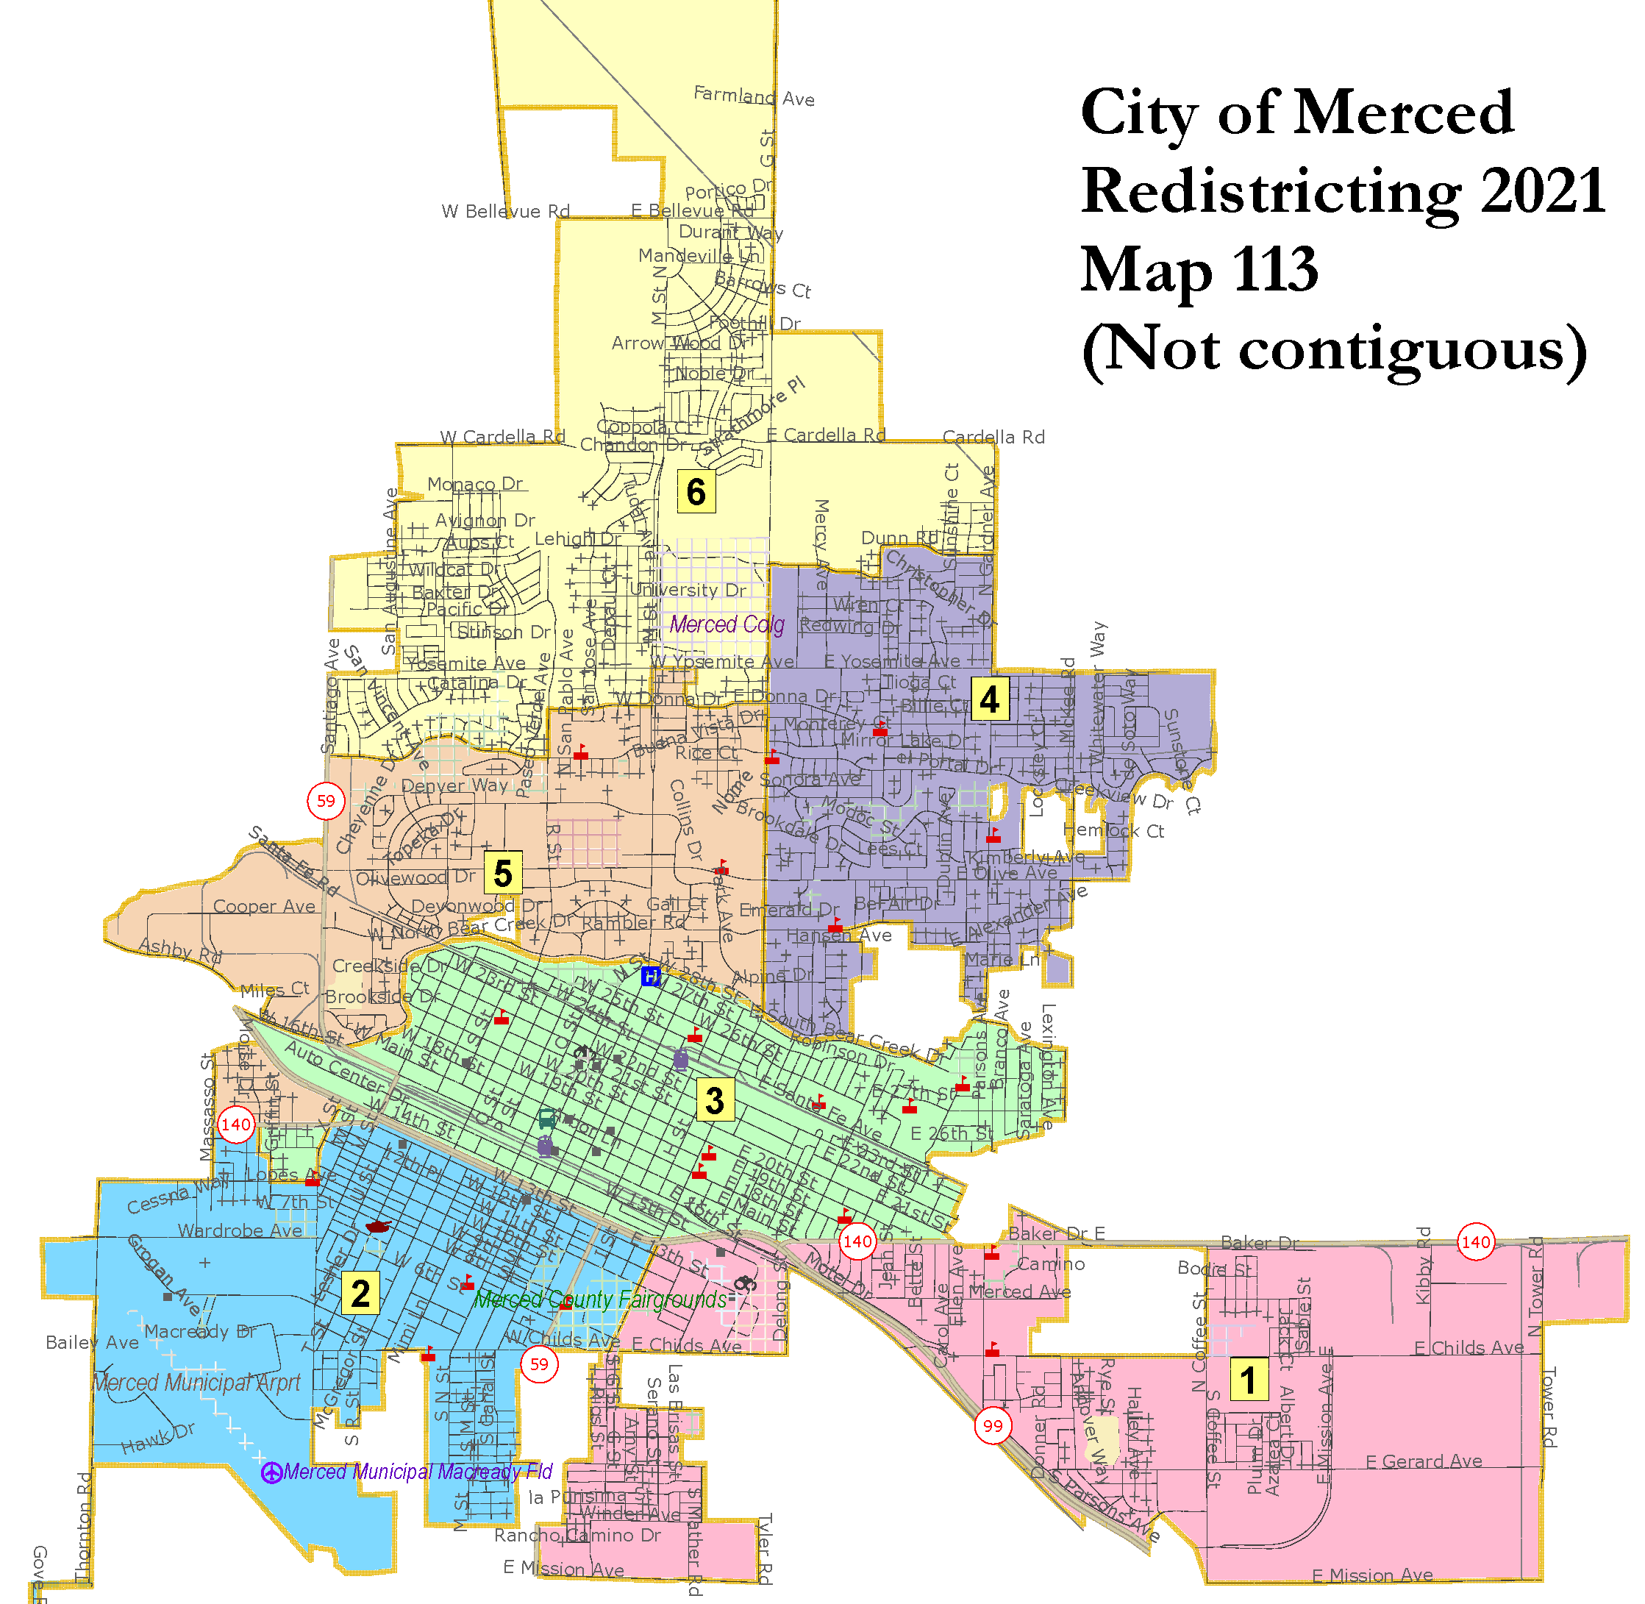
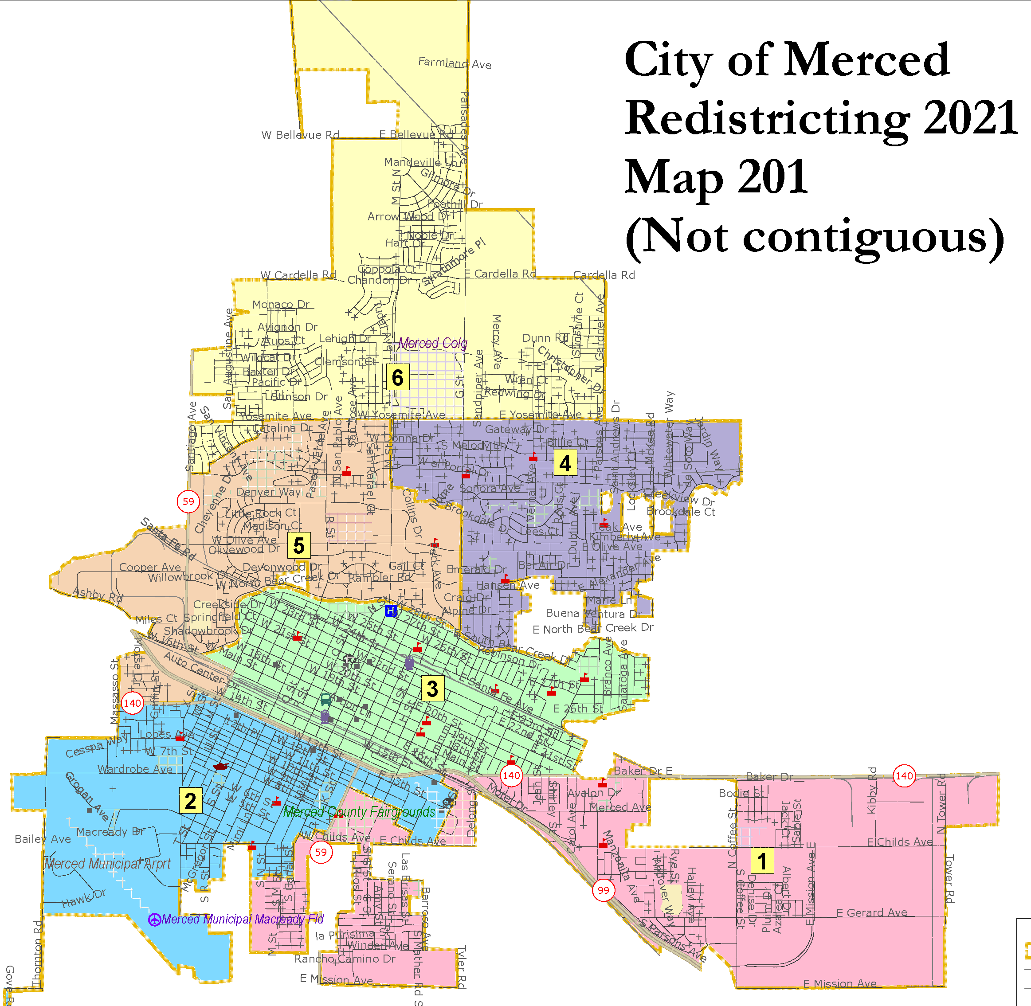
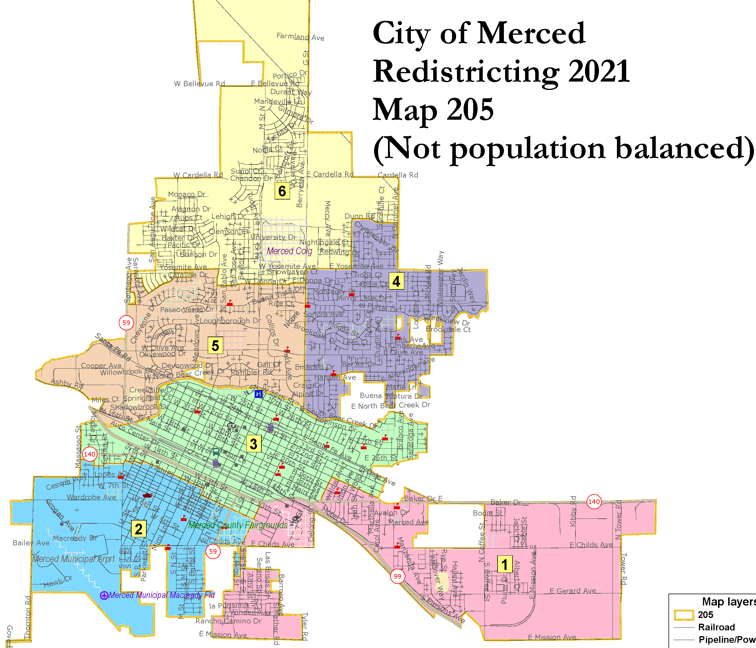
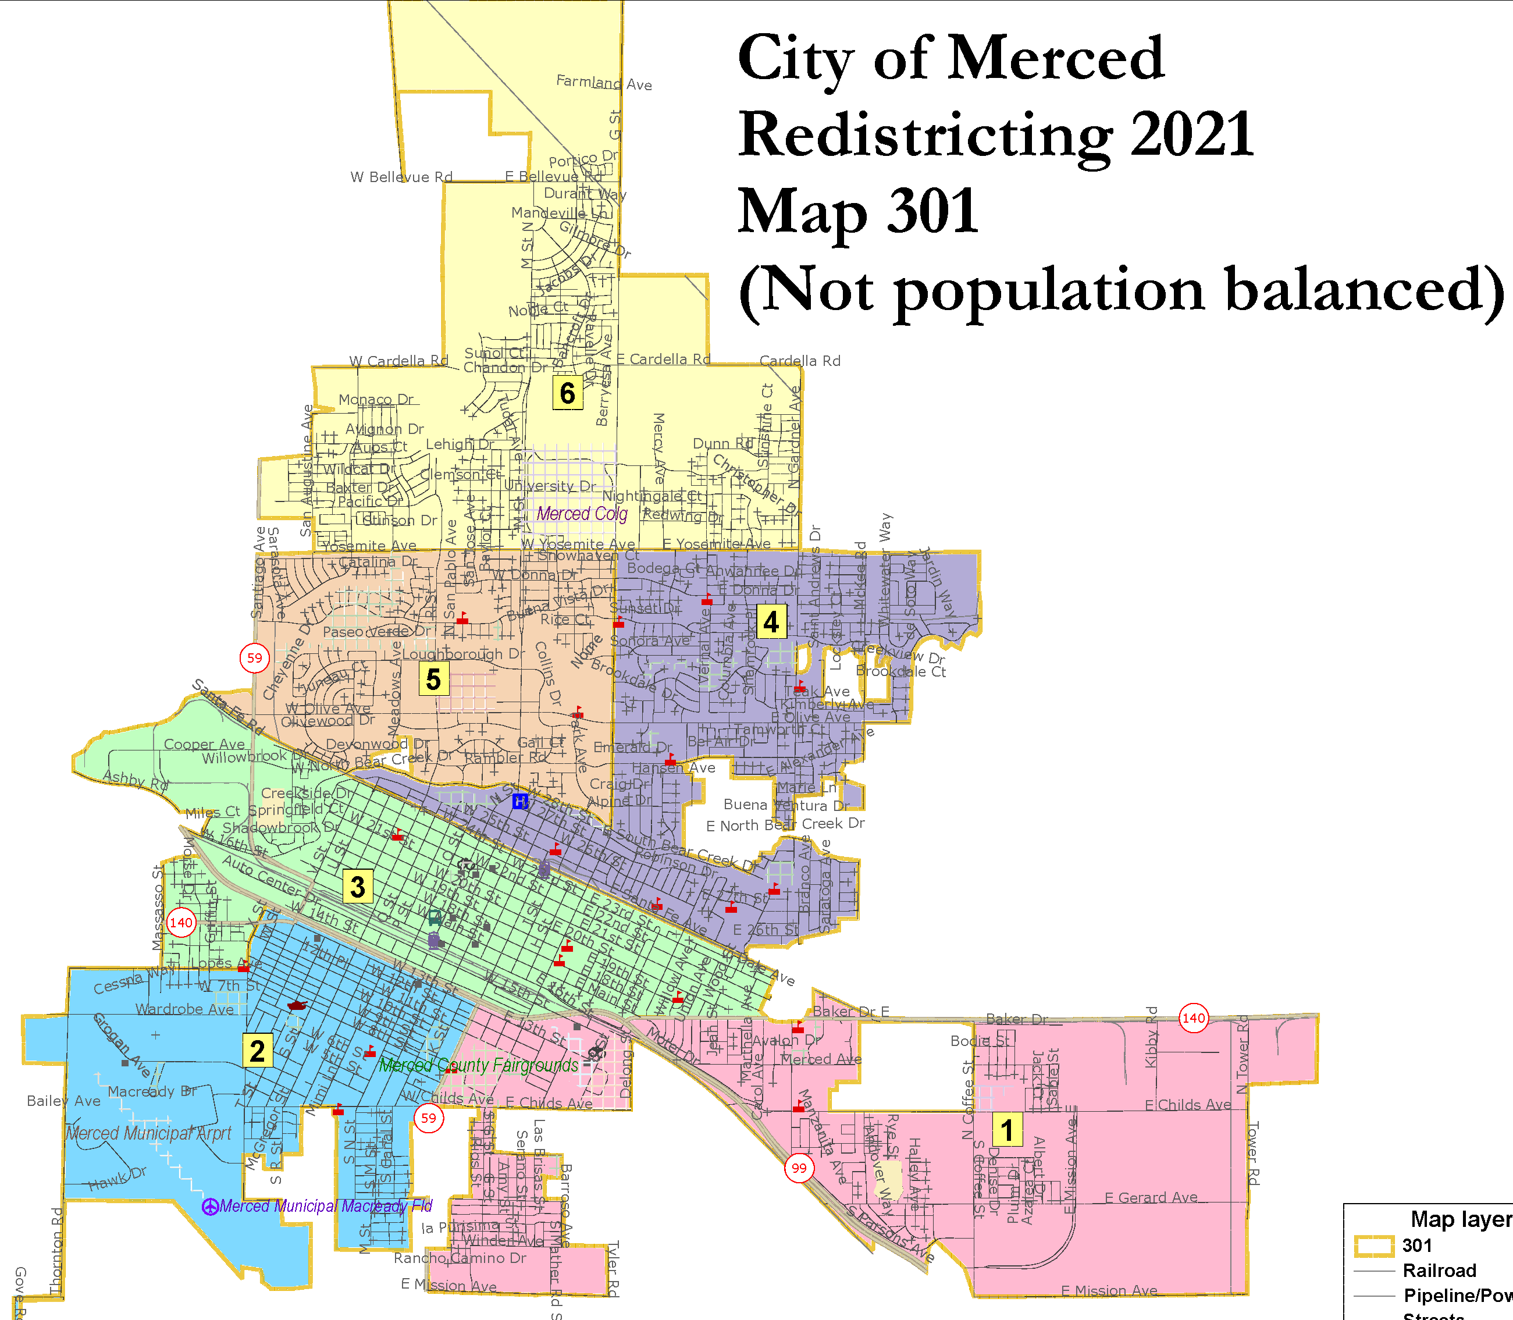
Not Population Balanced or Not Contiguous

Slide 10
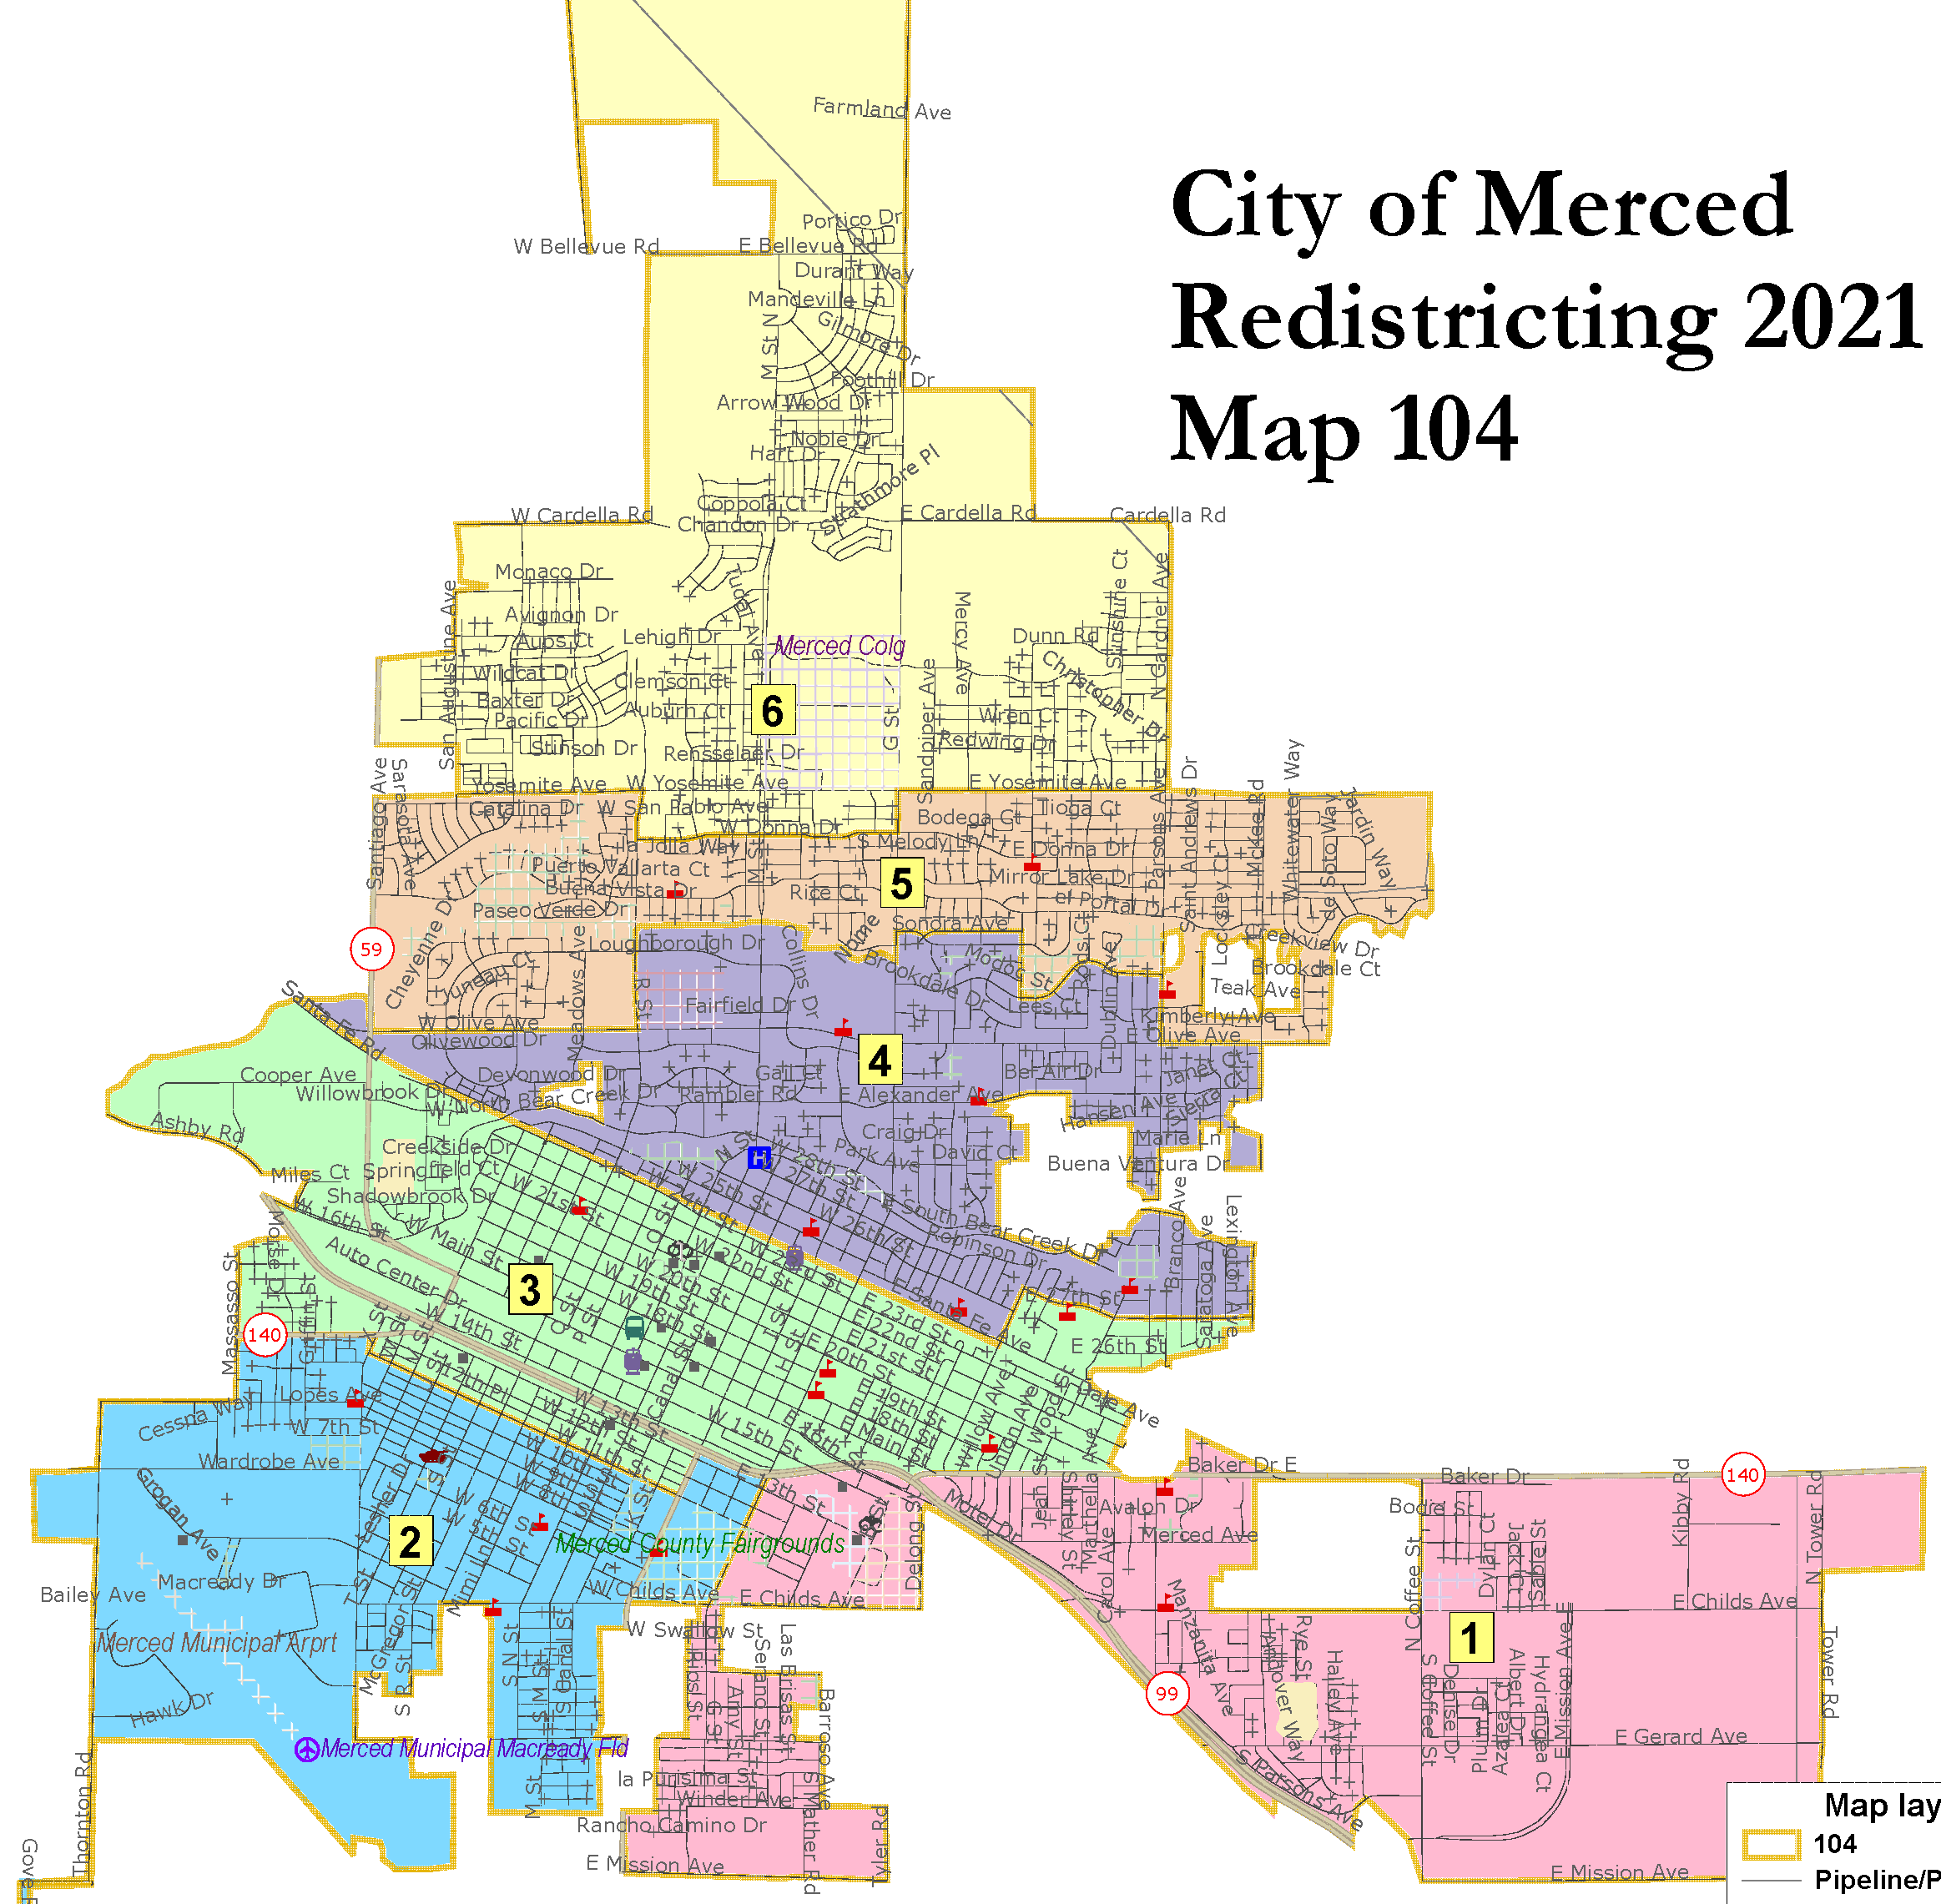
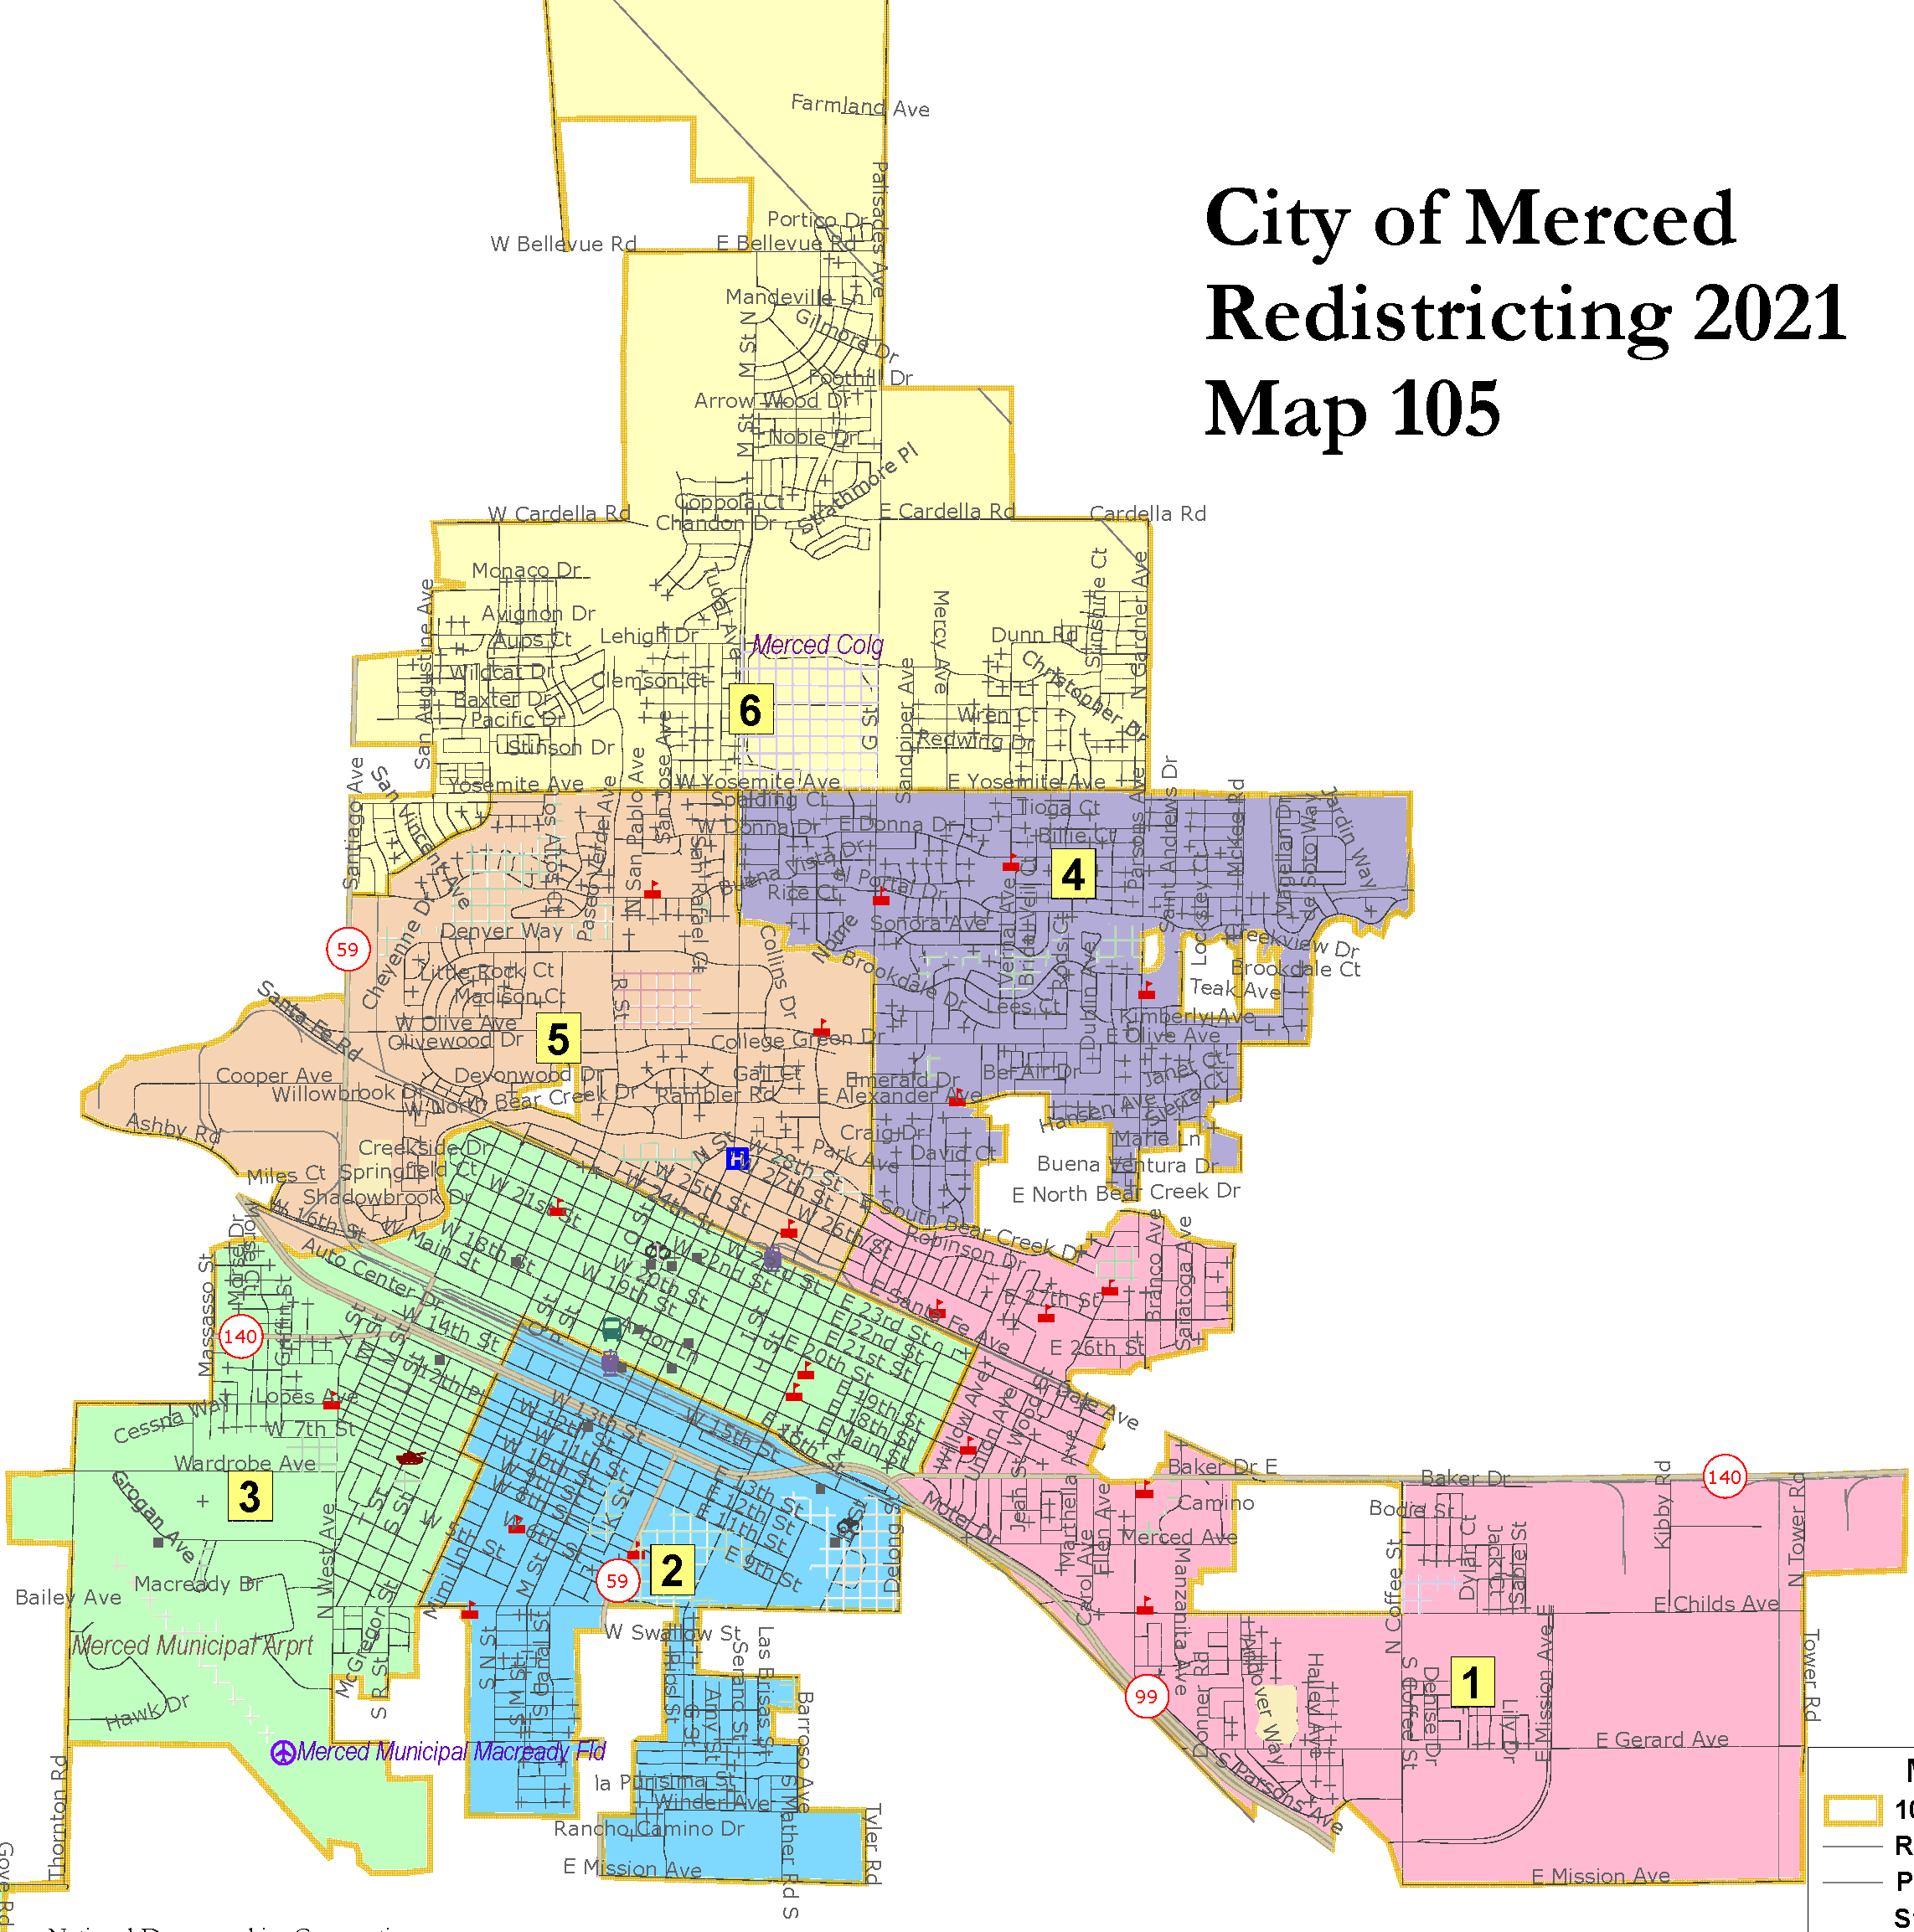
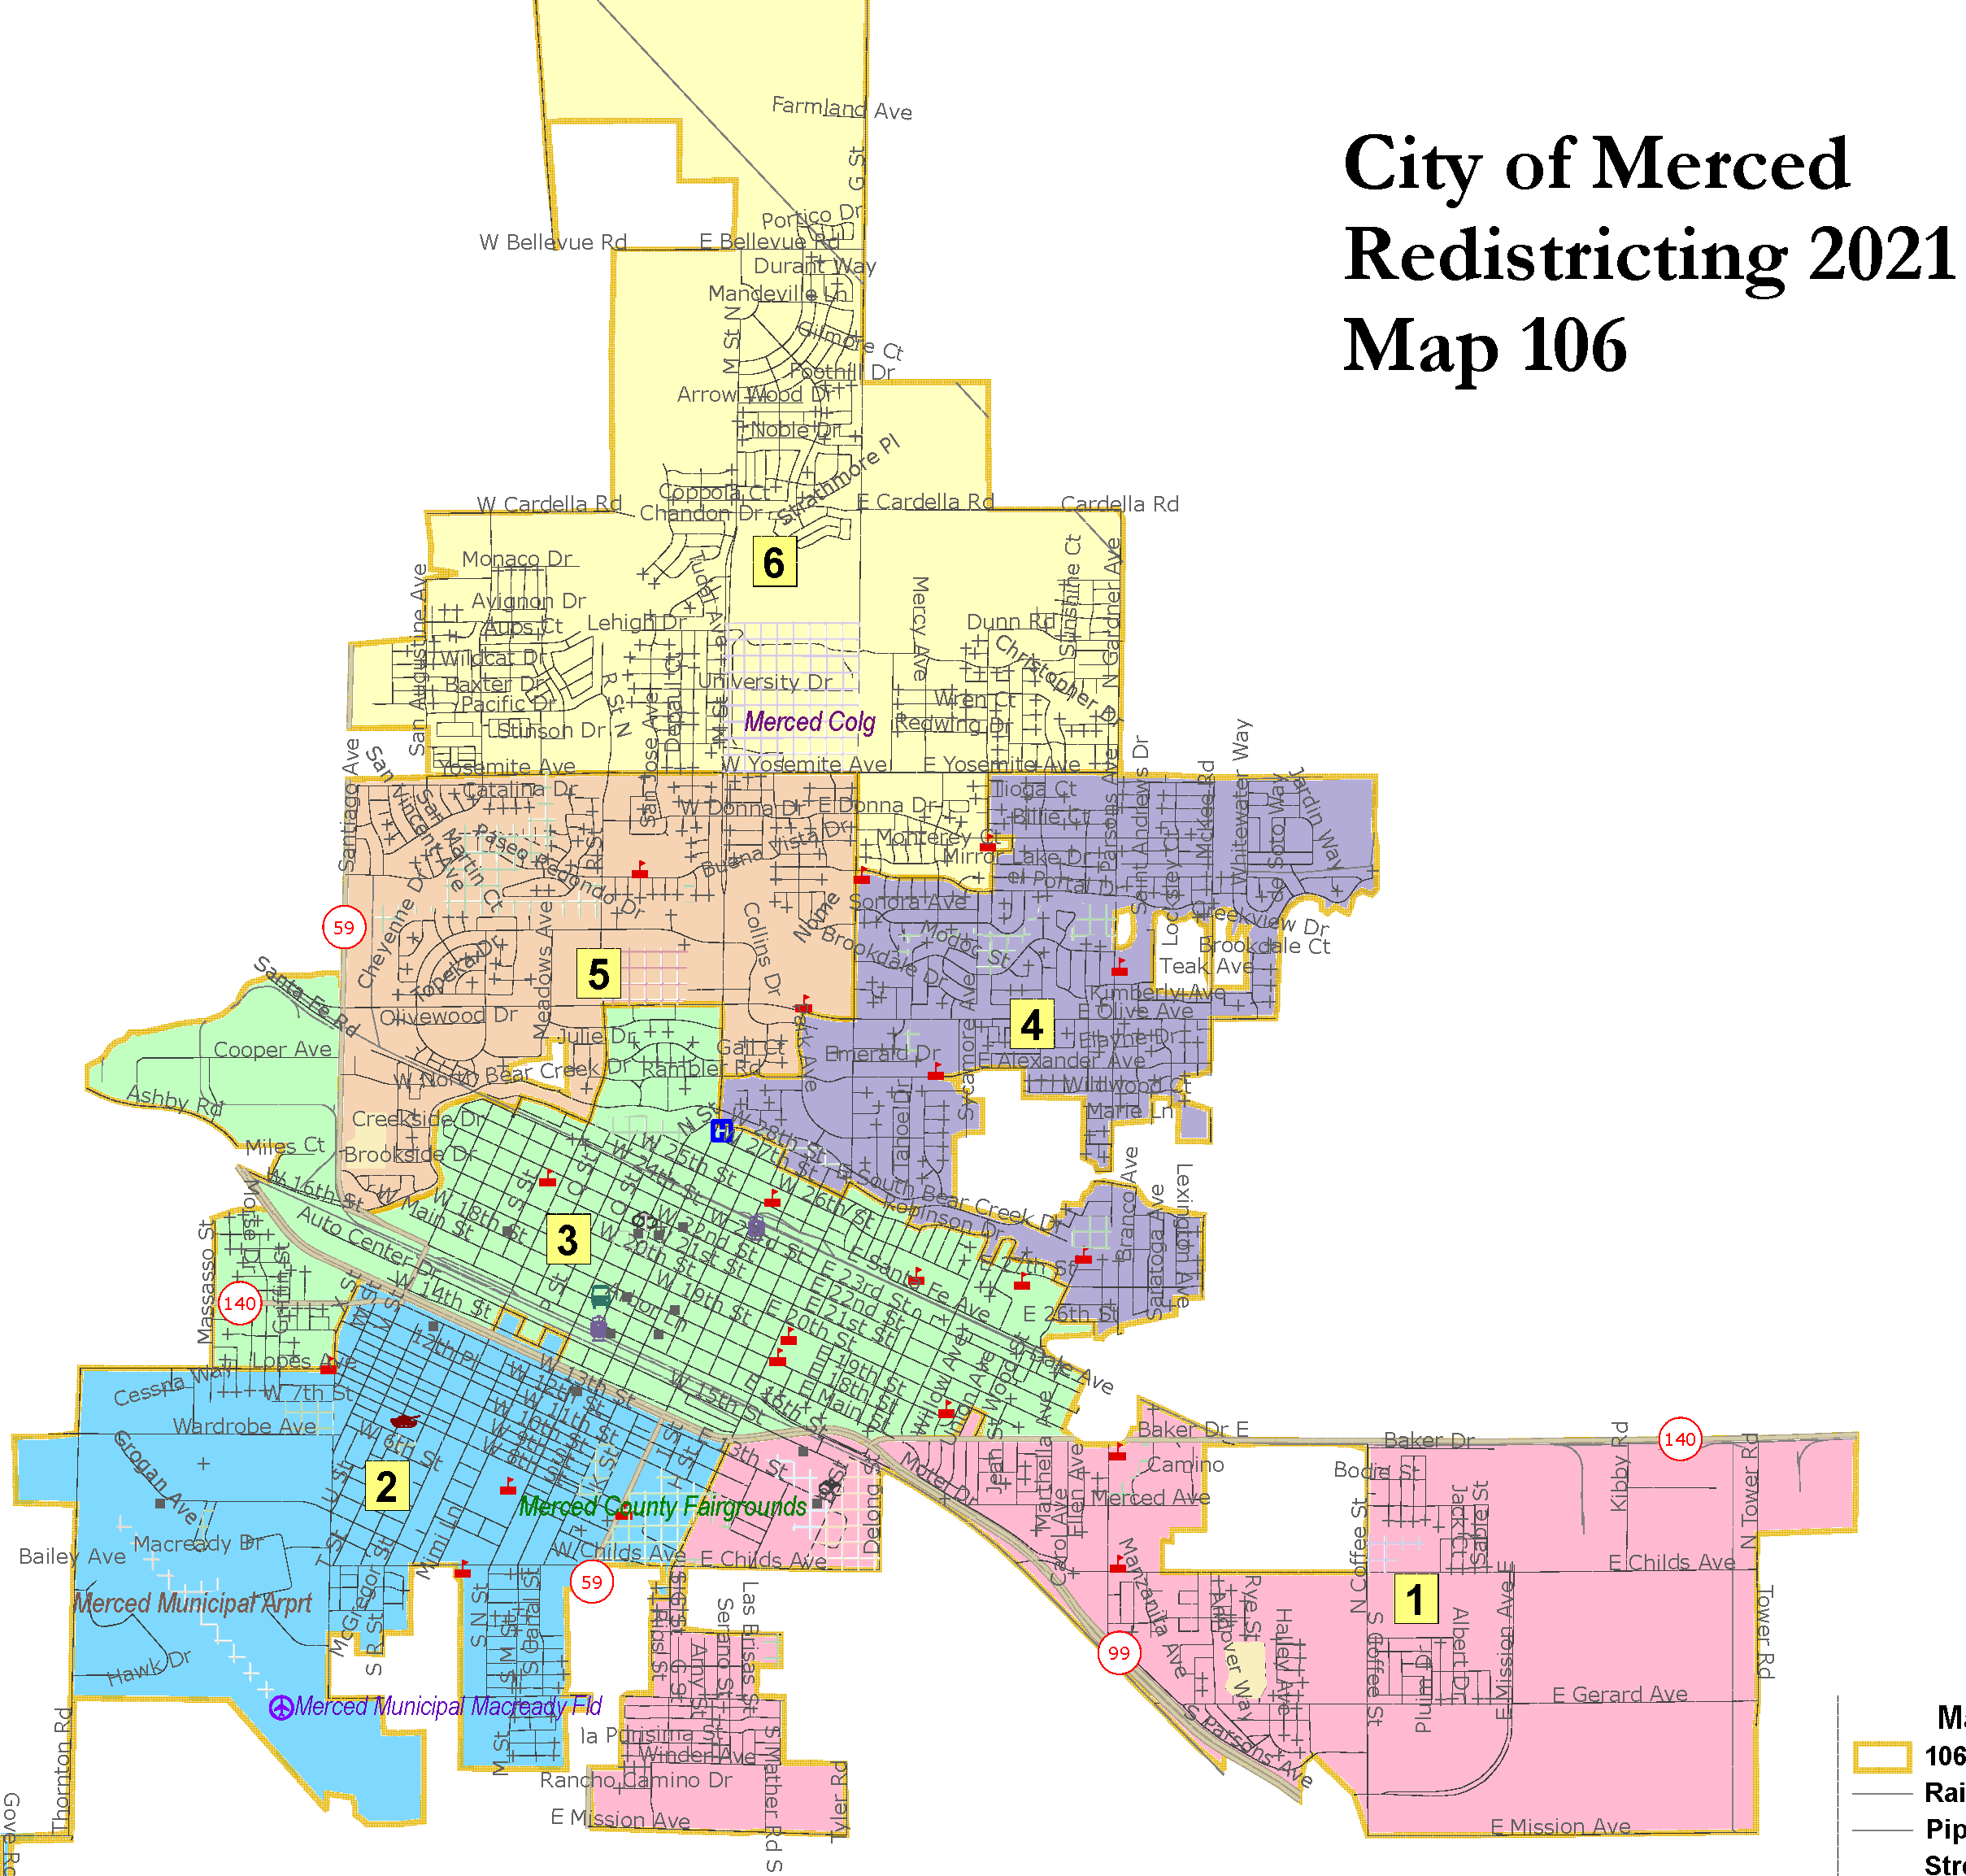
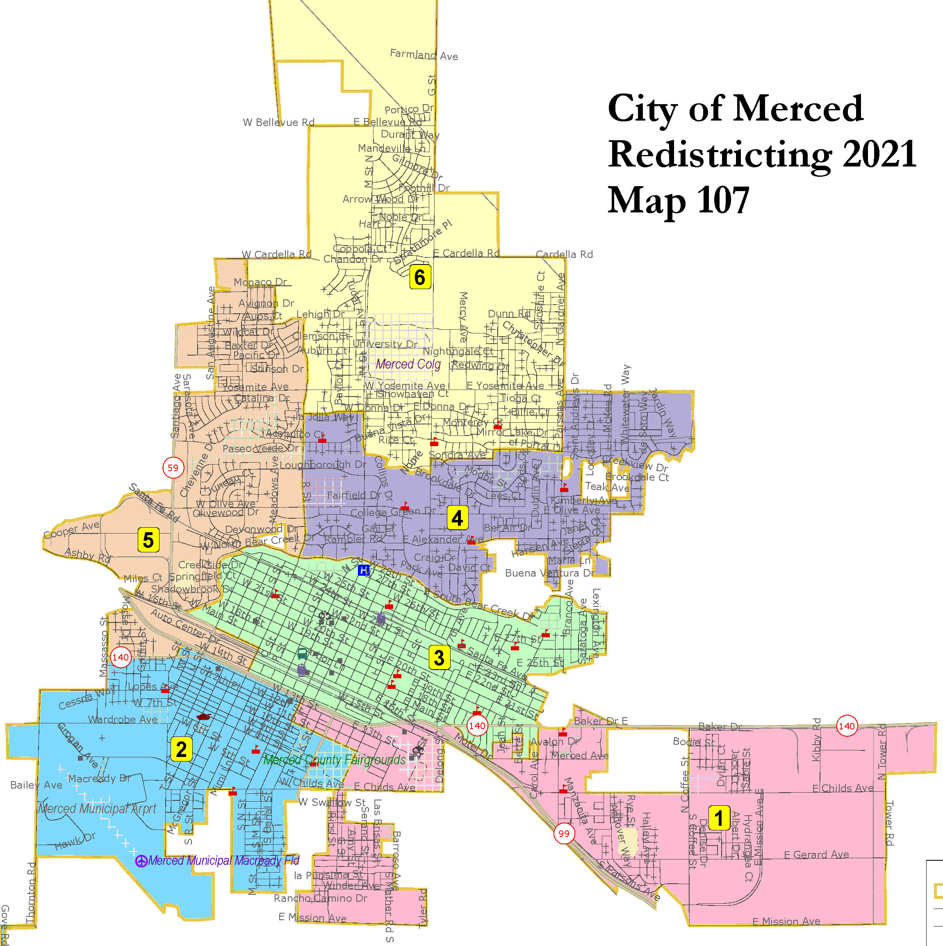
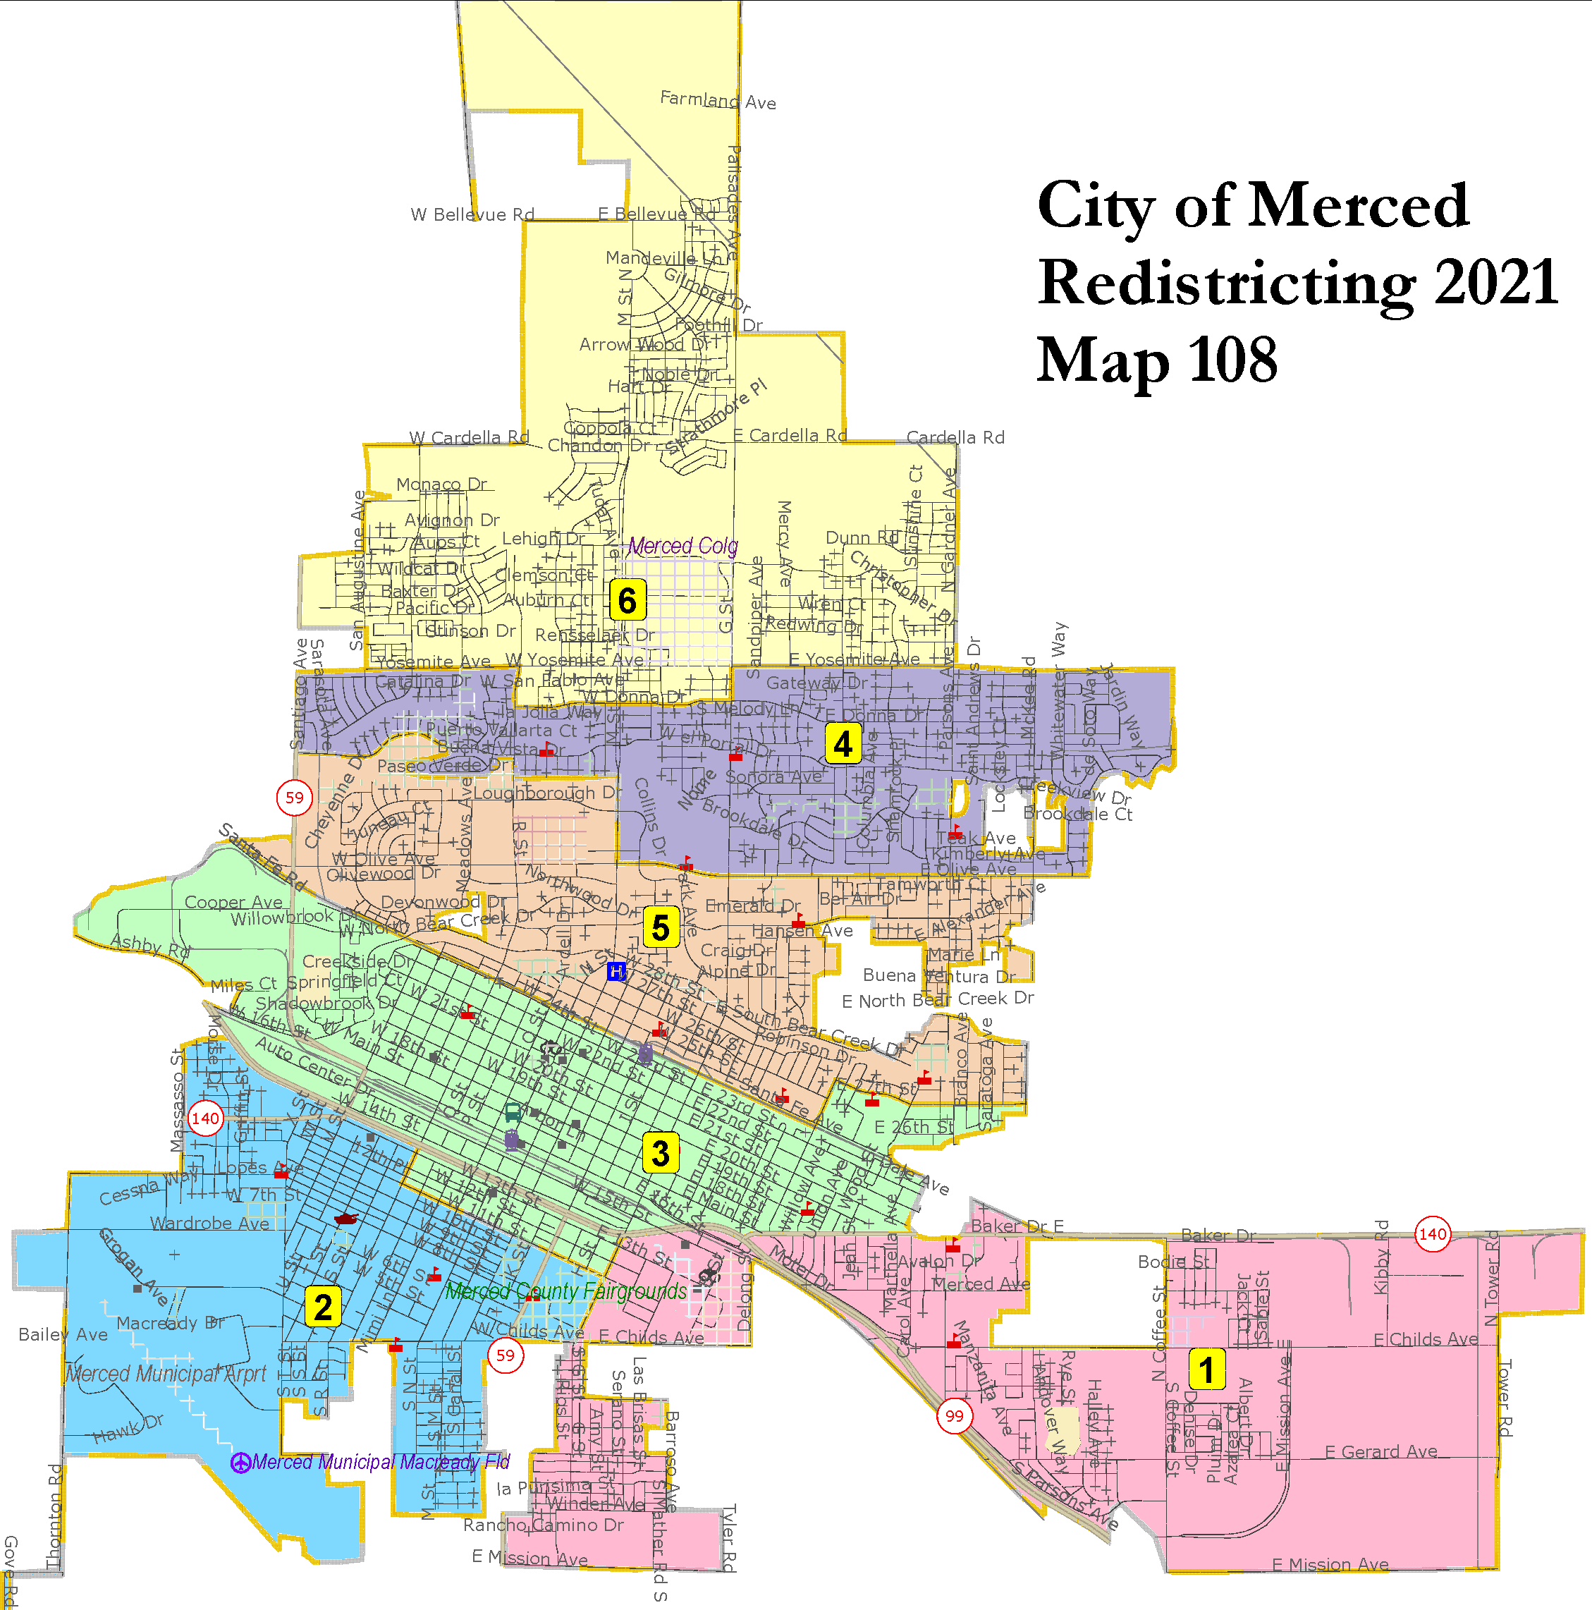
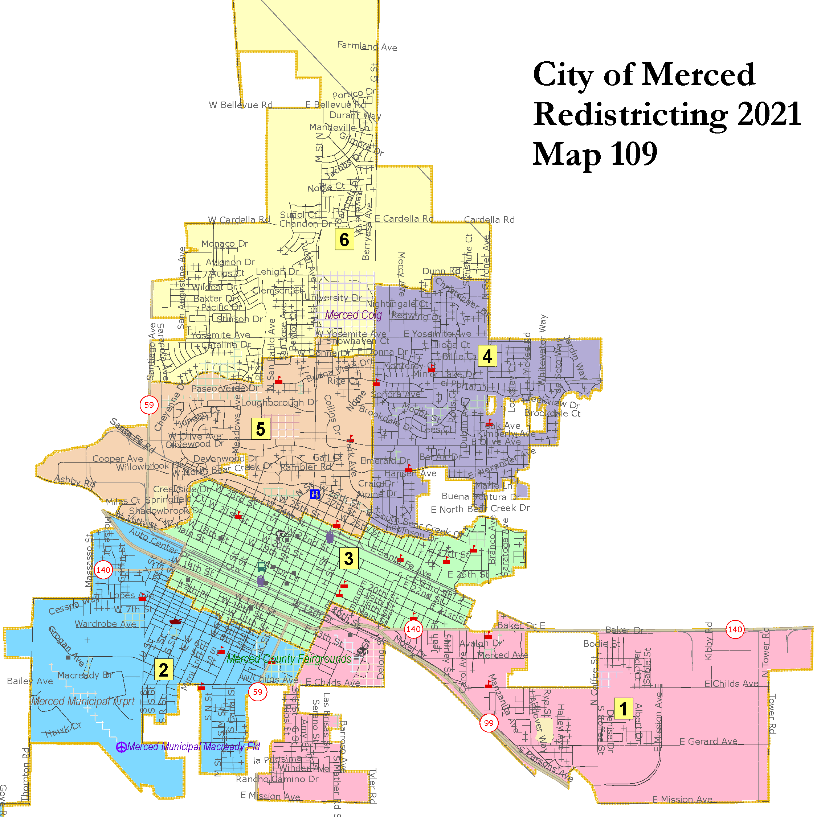
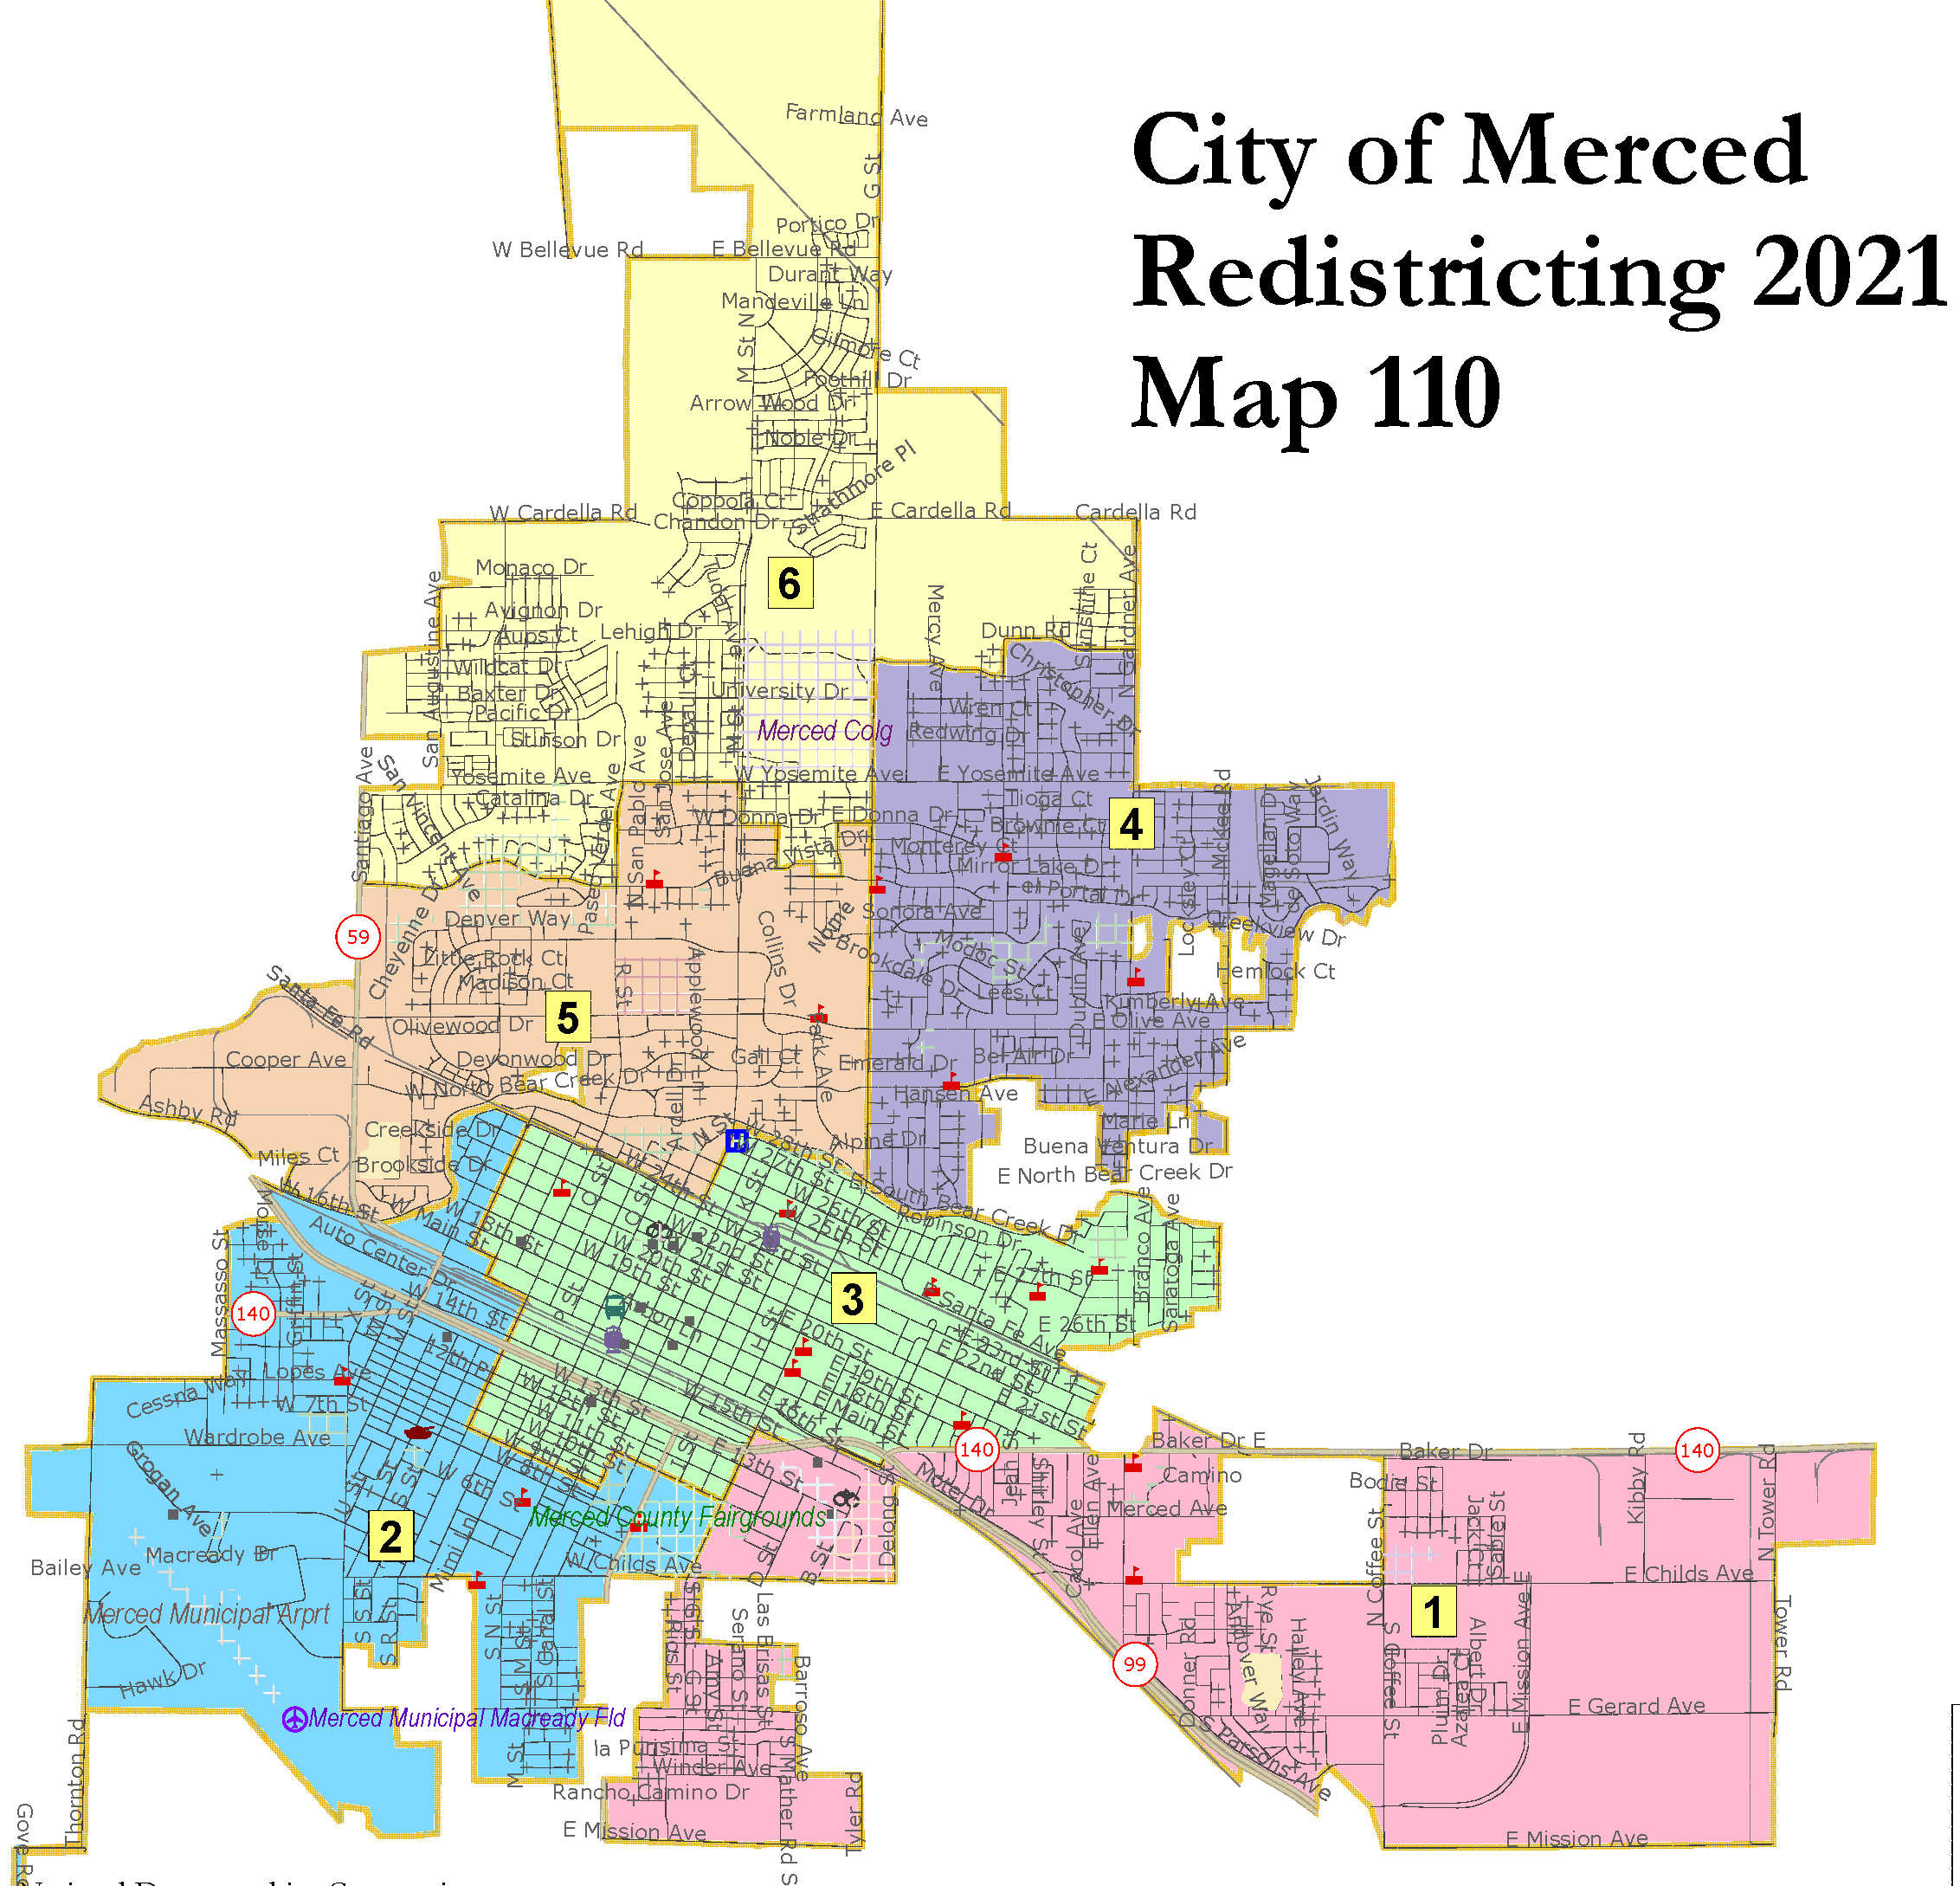
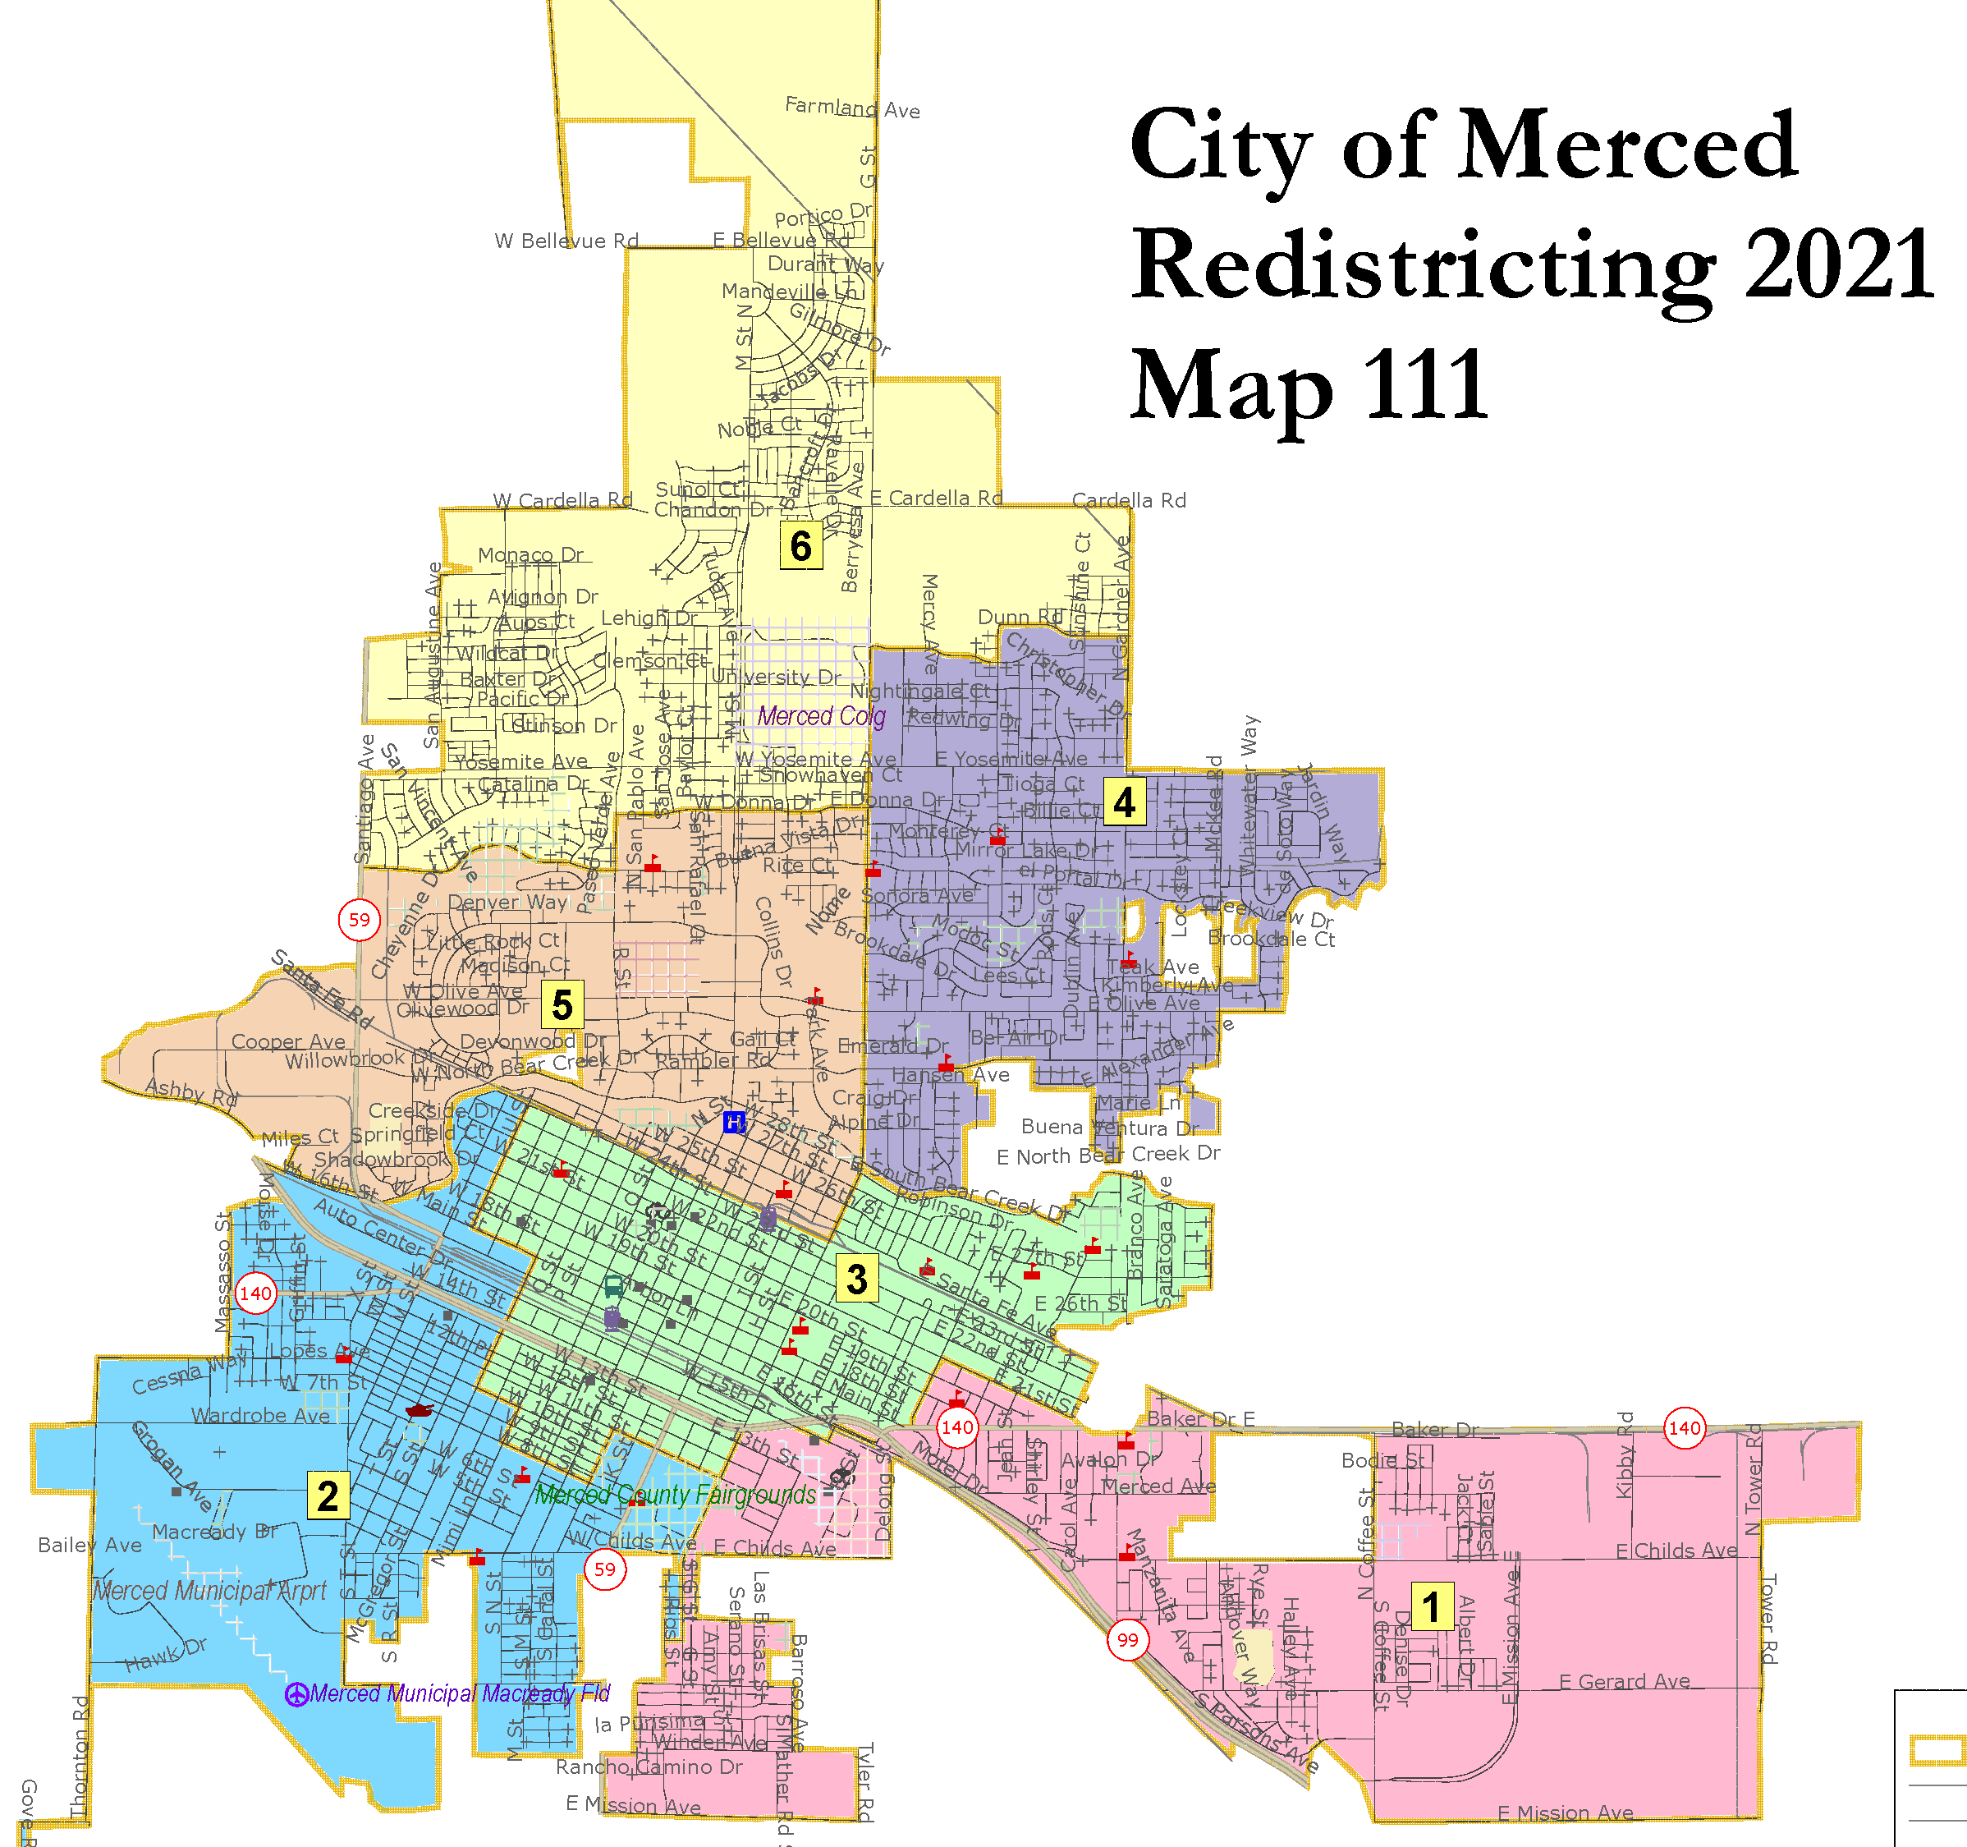
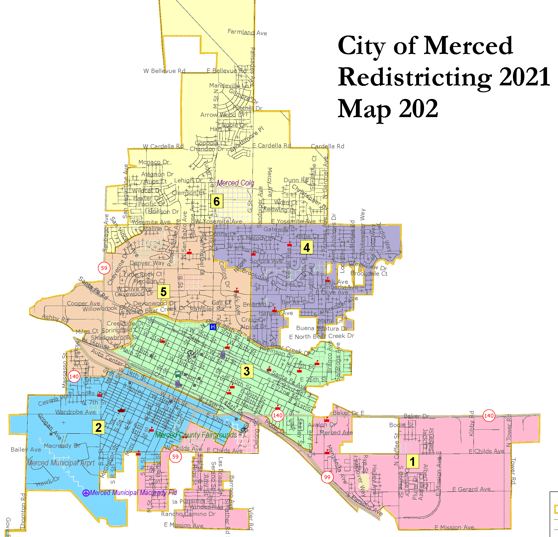
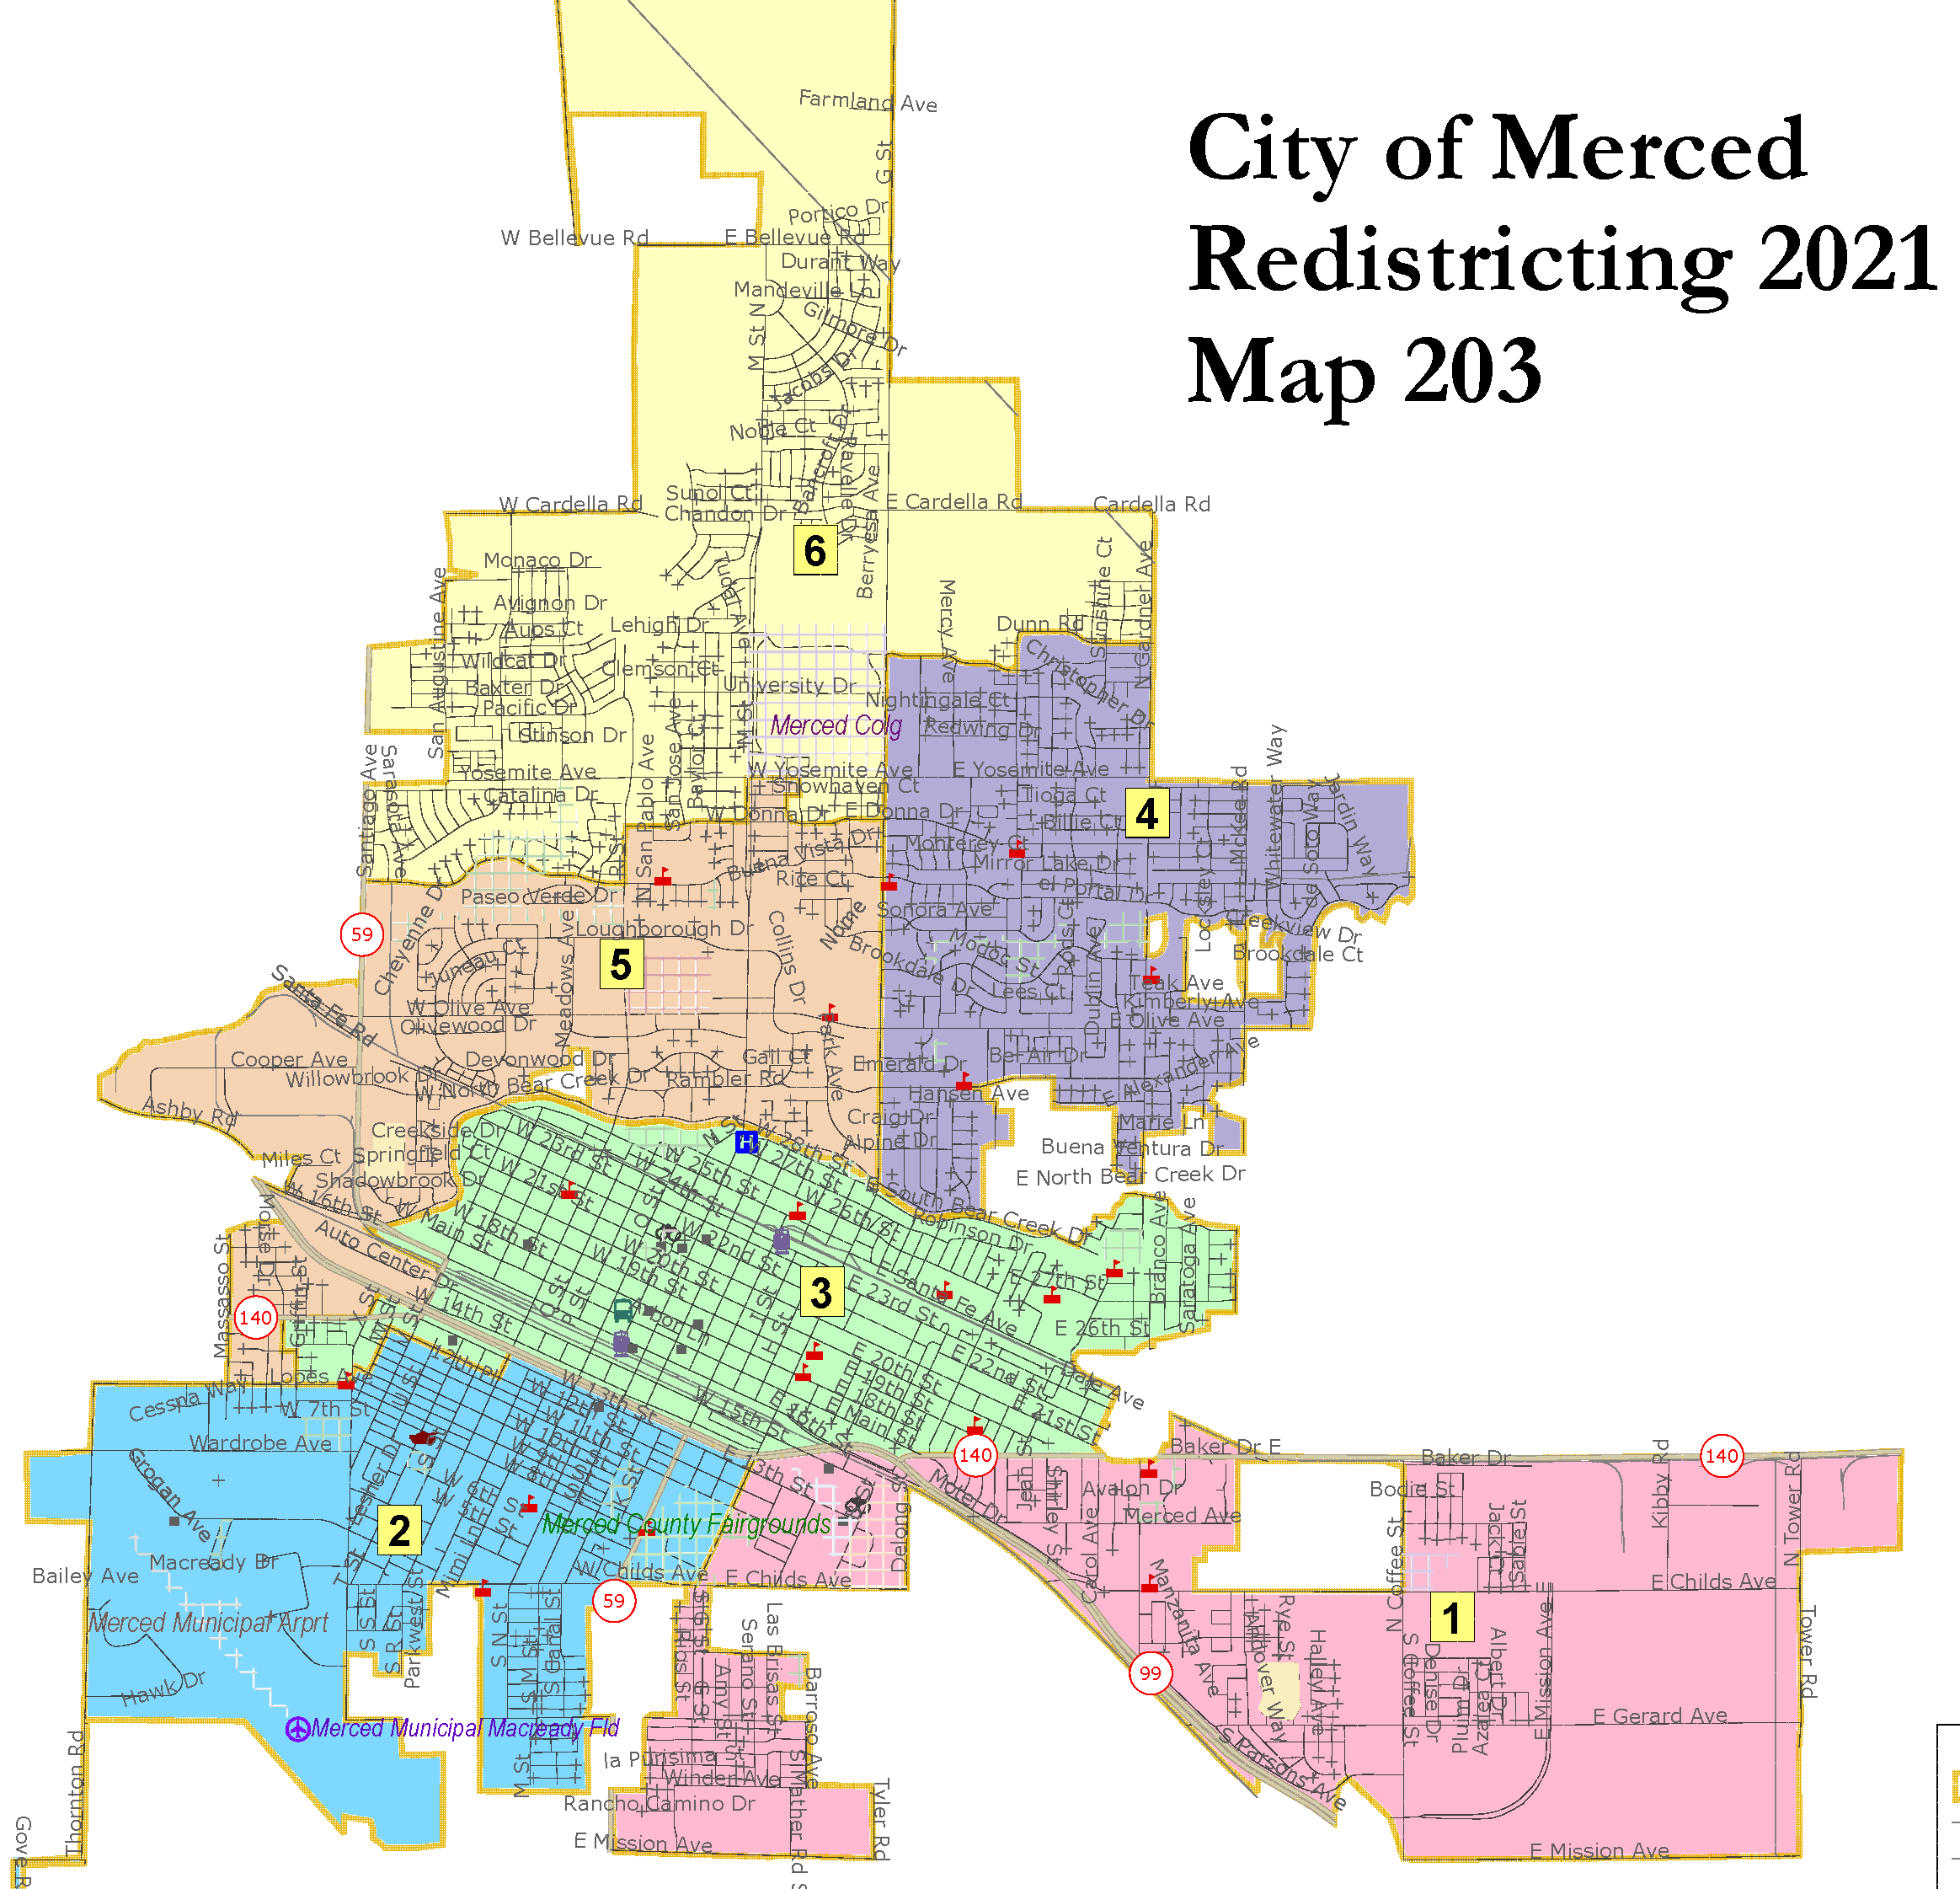
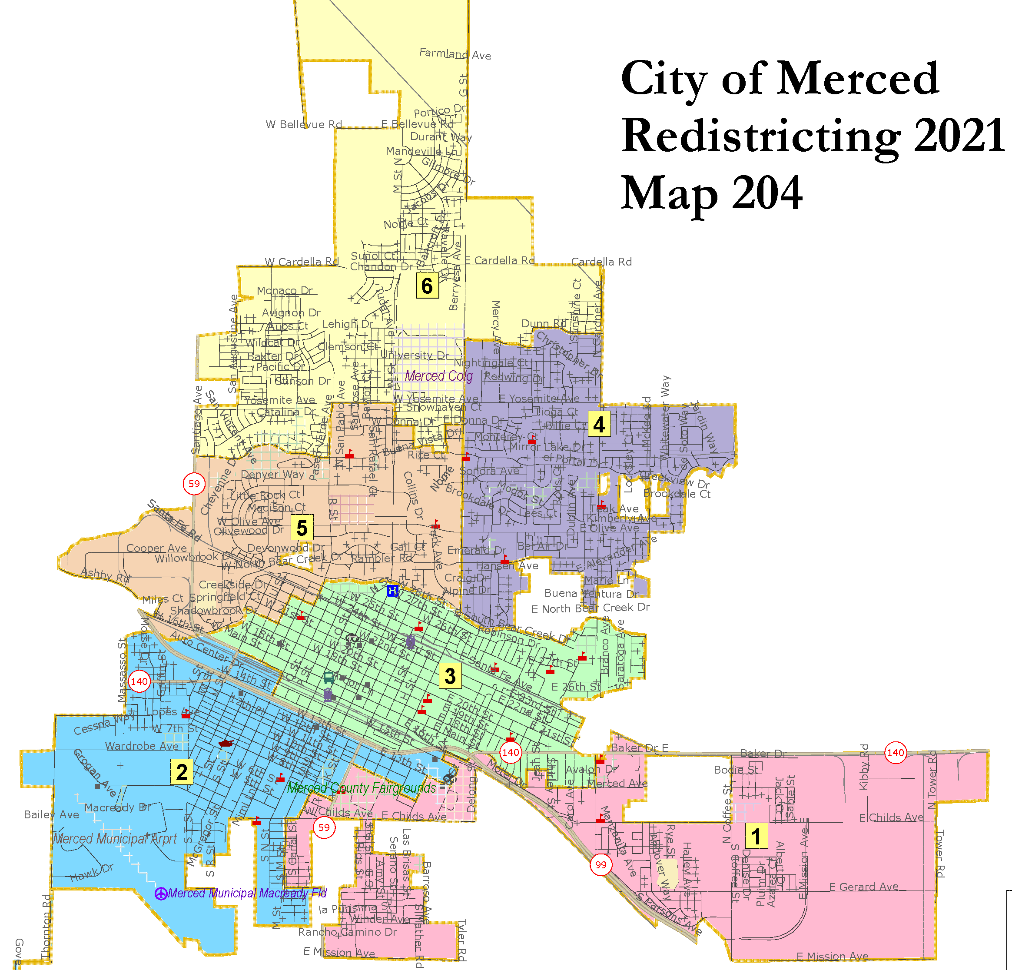
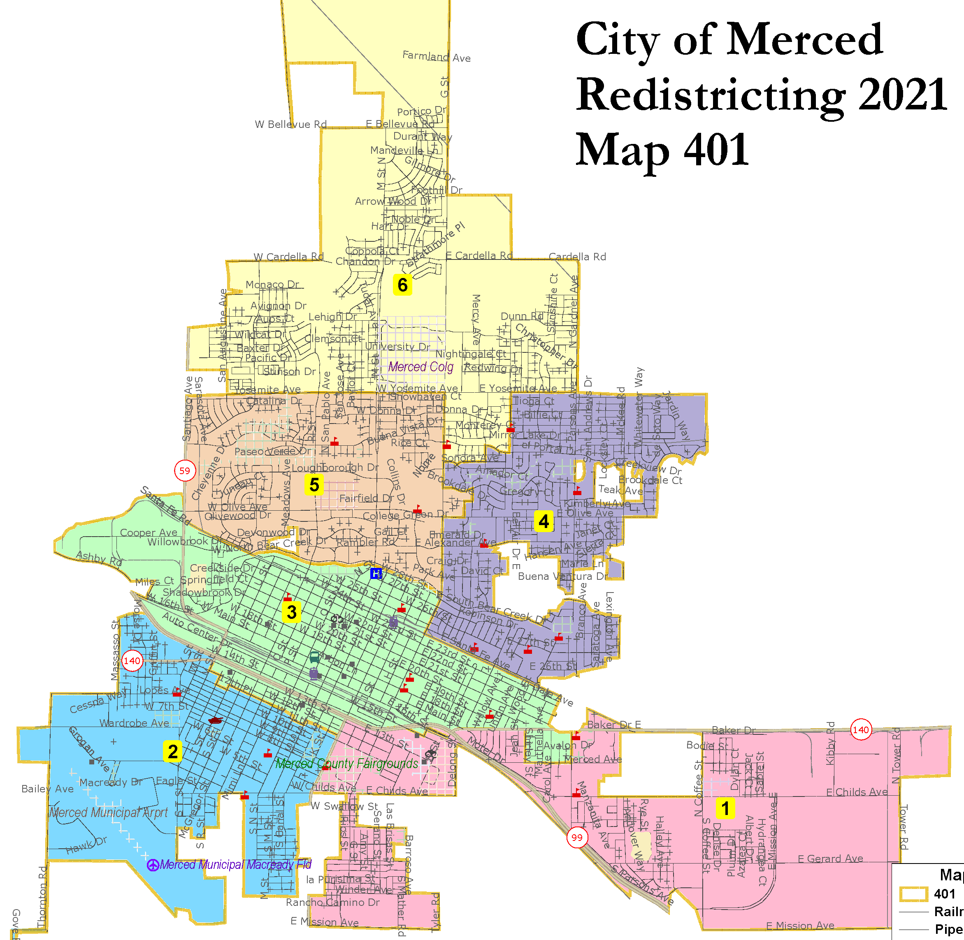
Draft Maps

Slide 11
Map 104
Of Note:
Deviation: 9.92%
6 overall majority minority CVAP districts
3 Latino CVAP districts

Slide 12
Map 105
Of Note:
Deviation: 3.63%
6 overall majority minority CVAP districts
2 Latino CVAP districts

Slide 13
Map 106
Of Note:
Deviation: 2.70%
6 overall majority minority CVAP districts
2 Latino CVAP districts

Slide 14
Map 107
Of Note:
Deviation: 5.82%
6 overall majority minority CVAP districts
2 Latino CVAP districts

Slide 15
Map 108
Of Note:
Deviation: 6.37%
6 overall majority minority CVAP districts
3 Latino CVAP districts

Slide 16
Map 109
Of Note:
Deviation: 8.98%
6 overall majority minority CVAP districts
3 Latino CVAP districts

Slide 17
Of Note:
Deviation: 8.96%
6 overall majority minority CVAP districts
3 Latino CVAP districts

Slide 18
Of Note:
Deviation: 4.96%
6 overall majority minority CVAP districts
3 Latino CVAP districts

Slide 19
Of Note:
Deviation: 8.92%
6 overall majority minority CVAP districts
1 Latino CVAP district

Slide 20
Of Note:
Deviation: 3.60%
6 overall majority minority CVAP districts
2 Latino CVAP districts

Slide 21
Of Note:
Deviation: 6.60%
6 overall majority minority CVAP districts
1 Latino CVAP district

Slide 22
Of Note:
Deviation: 2.47 %
6 overall majority minority CVAP districts
3 Latino CVAP districts

Slide 23
Advisory Committee Recommends

Slide 24
Public Hearing

