Slide 1

City of Merced
Redistricting Public Workshop
Dr. Jeff Tilton, Senior Consultant
National Demographics Corporation

Slide 2
Our Schedule
AGENDA
Process, Rules and Goals
Neighborhoods/Communities of Interest
Mapping Tools
Next Steps
Notes:
Ryder

Slide 3
Redistricting Process
Step | Description
City Council Public Hearing June 21, 2021 | Held prior to release of draft maps Educate, solicit input on the communities in the Districts
Census Data Releases | Census Bureau releases official 2020 Census population data – August 12 California’s official ‘prisoner-adjusted’ 2020 redistricting data – Sept. 20, 27
RAC Public Hearing September 15, 2021 | Held prior to release of draft maps Educate, solicit input on the communities in the Districts
Public Workshop November 6, 2021 | Gather data on communities of interest, neighborhoods Learn more about the public mapping tools
RAC Public Hearing December 1, 2021, 6 p.m. | Held prior to release of draft maps Educate, solicit input on the communities in the Districts
Public Workshop January 12, 2022, 6 p.m. | Gather data on communities of interest, neighborhoods Learn more about the public mapping tools
RAC Public Hearing January 22, 2022, 10 a.m. | Review neighborhoods/communities of interest Discuss and recommend up to two (2) draft maps Deadline to submit maps: January 7, 2022, 5 p.m.
City Council Public Hearing February 7, 2022, 6 p.m. | Discuss, revise draft maps (if necessary)
City Council Public Hearing March 7, 2022, 6 p.m. | Discuss, determine final map; discuss, determine election sequencing Draft maps posted deadline: February 28, 2022, 5 p.m.

Slide 4

Redistricting Rules and Goals
1. Federal Laws
2. California Criteria for
Cities
3. Other Traditional Redistricting Principles
Equal Population
Federal Voting Rights Act
No Racial Gerrymandering
Geographically contiguous
Undivided neighborhoods and “communities of interest”
Easily identifiable boundaries
Compact
Prohibited: “Shall not favor or discriminate against a political party.”
Minimize voters shifted to different election years
Respect voters’ choices / continuity in office
Future population growth
Preserving the core of existing districts

Slide 5
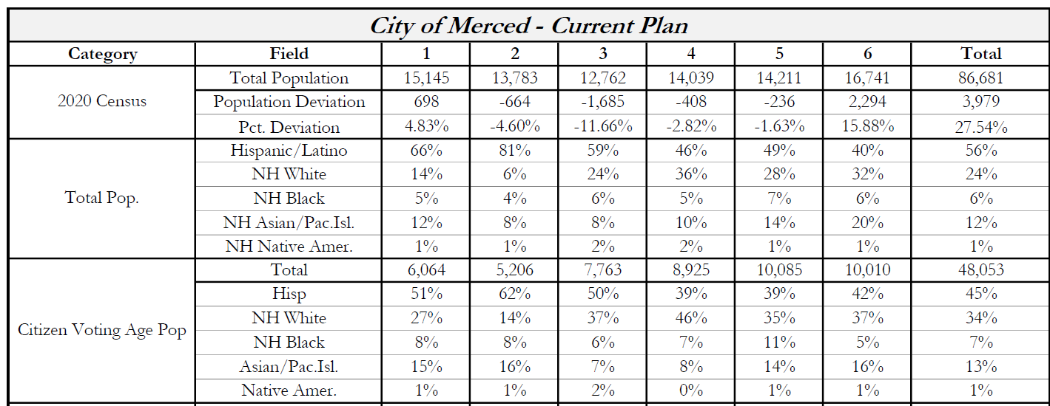
2020 Census
Ideal population per District: 14,447

Slide 6

Defining Neighborhoods
1st Question: What is your neighborhood?
2nd Question: What are its geographic boundaries?
Examples of physical features defining a neighborhood boundary:
Natural neighborhood dividing lines, such as highway or major roads, rivers, canals and/or hills
Areas around parks or schools
Other neighborhood landmarks
In the absence of public testimony, planning records and other similar documents may provide definition.

Slide 7
Beyond Neighborhoods:
Defining Communities of Interest
1st Question: What defines your community?
Geographic Area, plus
Shared issue or characteristic
  Shared social or economic interest
  Impacted by county policies
Tell us “your community’s story”
2nd Question: Would this community benefit from being “included within a single district for purposes of its effective and fair representation”?
Or would it benefit more from having multiple representatives?
Definitions of Communities of Interest may not include relationships with political parties, incumbents, or political candidates.

Slide 8
Possible Neighborhoods / Communities

Slide 9
Public Mapping and Map Review Tools
Different tools for different purposes
Different tools for different levels of technical skill and interest
  Simple “review draft maps” tool
  Easy-to-use “Draw your neighborhood” tool
  Paper- and Excel-based simple “Draw a draft map” tools
  Powerful, data-rich “Draw a draft map” tool
  NEW OPTION: Submit using your own mapping software
Whether you use the powerful (but complicated) online mapping tool, Excel, the paper kit, or just draw on a napkin, we welcome your maps!

Slide 10
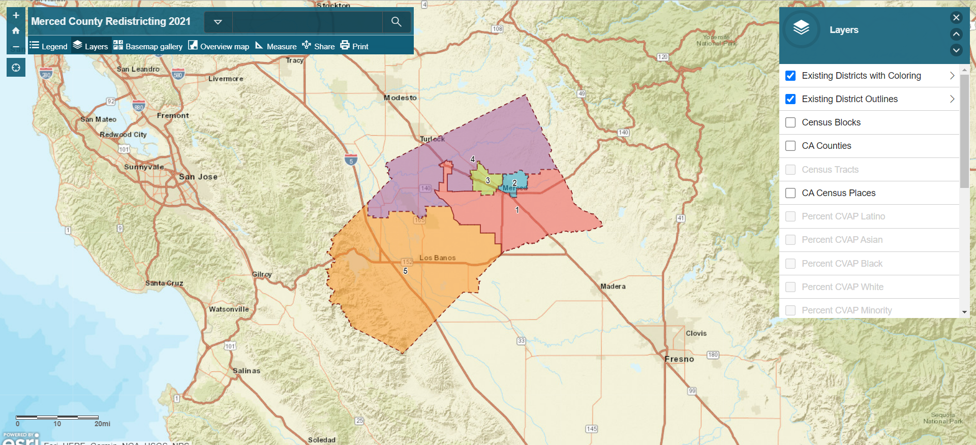
Simple Map Review Tool
Online Interactive Review Map
ESRI’s “ArcGIS Online” – similar to Google Maps in ease of use
Used to review, analyze and compare maps, not to create them
Includes overlays of “community of interest” and other data
Example: Merced County

Slide 11
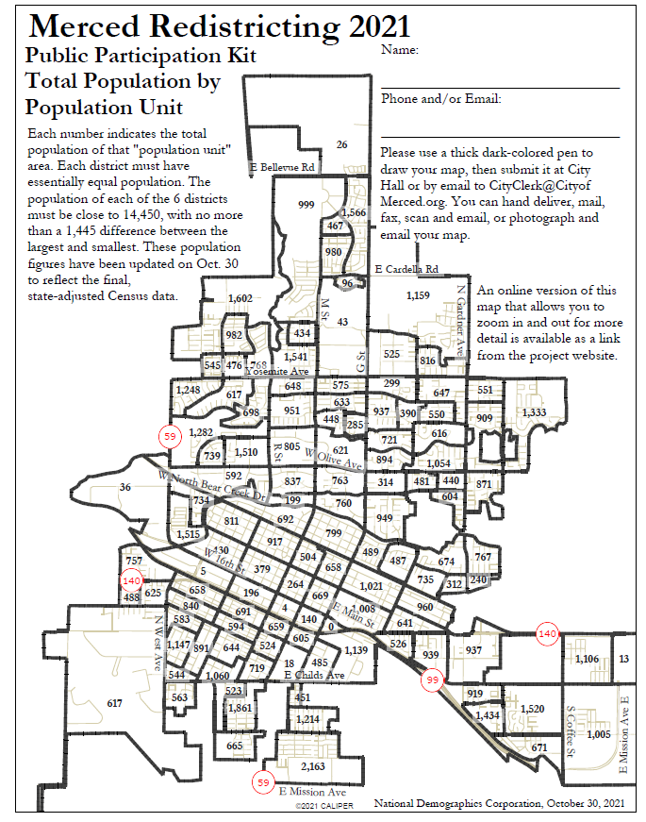
Simple Map Drawing Tool
Paper “Public Participation Kit”
For those without internet access or who prefer paper
Total Population Counts only – no demographic numbers

Slide 12
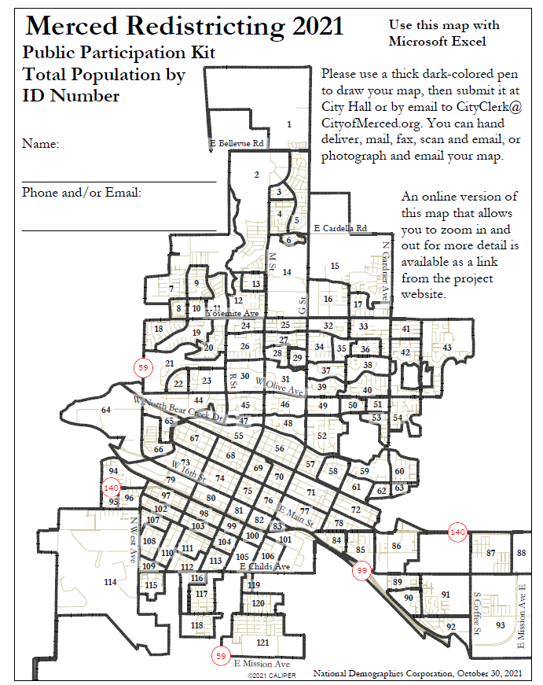
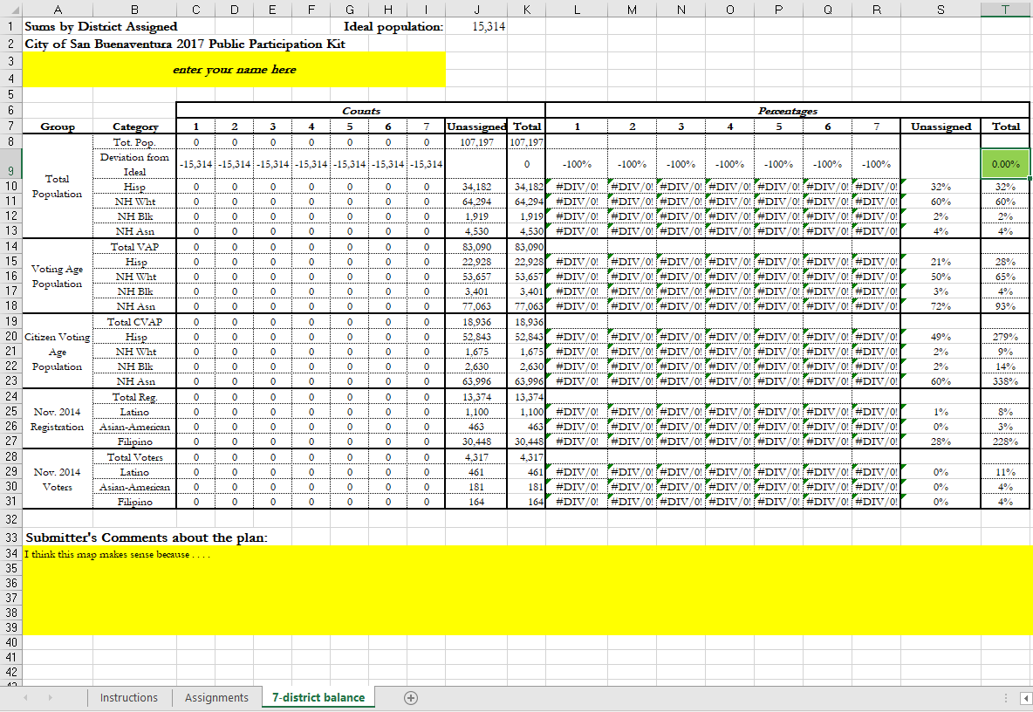
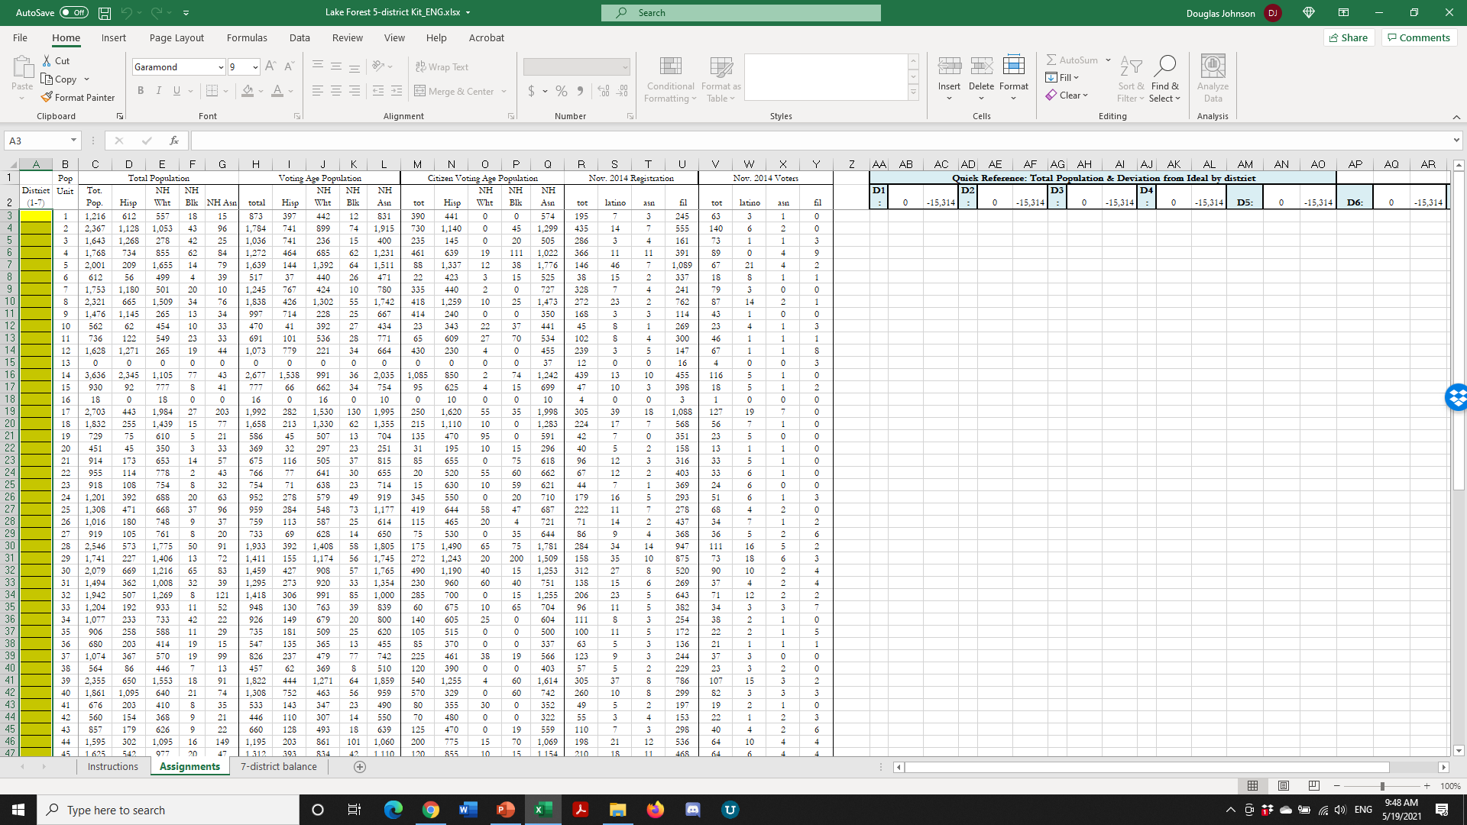
Simple Map Drawing Tool + Excel Supplement
“Public Participation Kit”
For those who know Excel and do not wish to use online tools
Adds CVAP data
Excel does the math

Slide 13
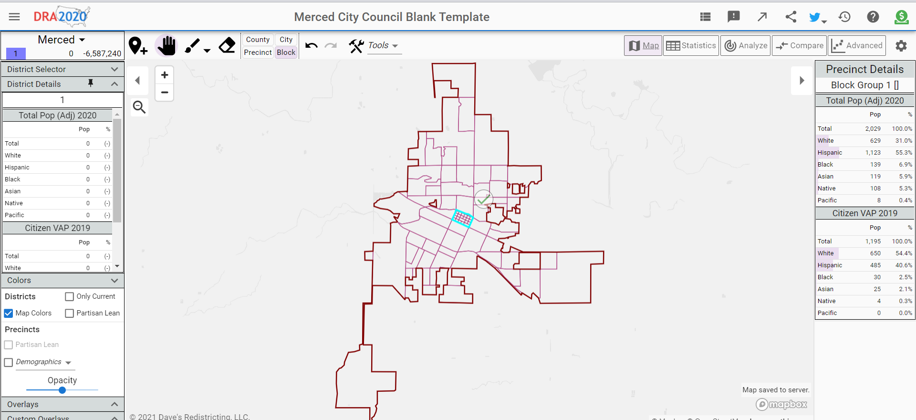
Dave’s Redistricting
“Draw Your Districts” focus
DavesRedistricting.org
November 6, 2021

Slide 14
Your own mapping software?
Feel free to submit using your own mapping software:
A GIS Shapefile and/or a Census Block equivalency file (w/2020 Census Blocks);
A description of the choices and key points of your map; and,
Send to the jurisdiction’s listed districting/redistricting email address

Slide 15
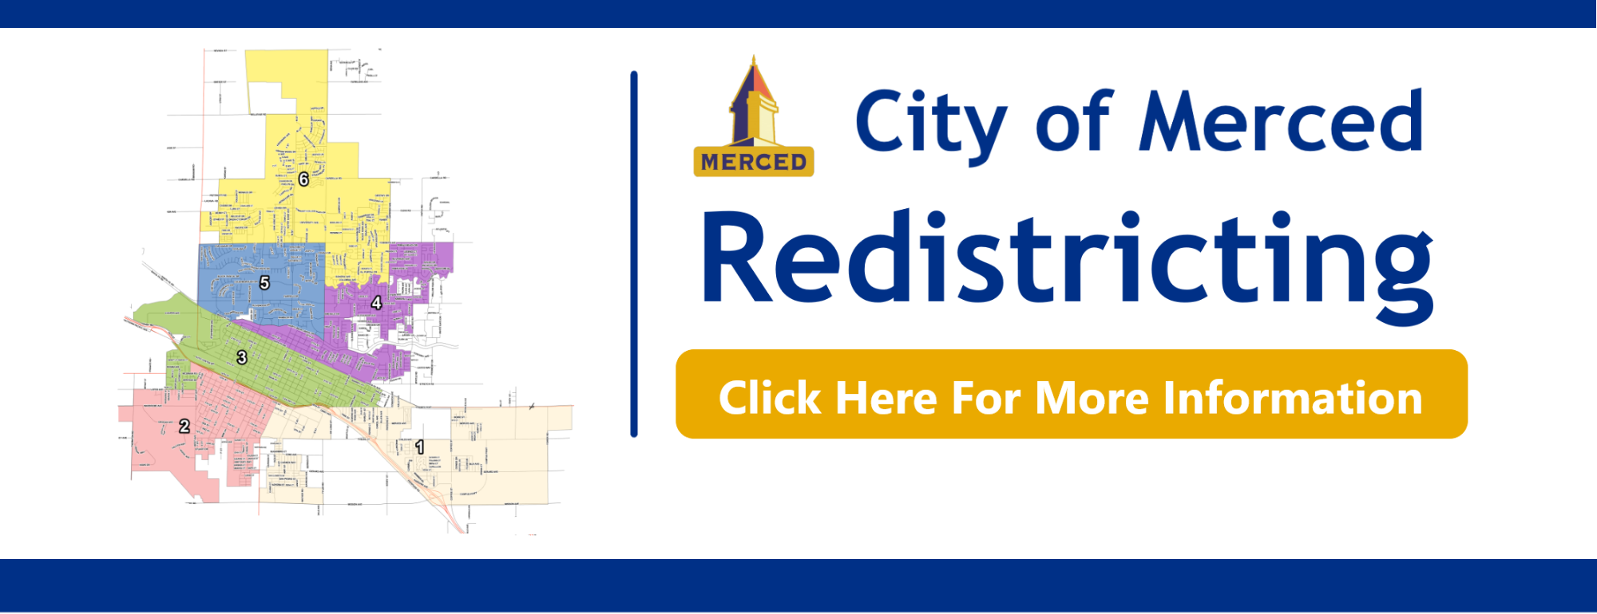
Stay connected
www.cityofmerced.org/redistricting
209.388.8650 | cityclerk@cityofmerced.org

