Slide 1
City of Merced Introduction to Redistricting
Dr. Jeff Tilton, Senior Consultant
National Demographics Corporation

Slide 2
Redistricting Process
Step | Description
City Council Public Hearing June 21, 2021 | Held prior to release of draft maps Educate, solicit input on the communities in the Districts
Census Data Release August 12, 2021 | Census Bureau releases official 2020 Census population data
RAC Public Hearing September 15, 2021 6 p.m. | Held prior to release of draft maps Educate, solicit input on the communities in the Districts
California Data Release September 20, 2021 | California Statewide Database releases California’s official ‘prisoner-adjusted’ 2020 redistricting data
Public Workshop November 6, 2021 10 a.m. | Gather data on communities of interest, neighborhoods Learn more about the public mapping tools
Dates/times subject to change

Slide 3
Redistricting Process (continued)
Step | Description
RAC Public Hearing December 1, 2021 6 p.m. | Held prior to release of draft maps Educate, solicit input on the communities in the Districts
Public Workshop January 12, 2022 6 p.m. | Gather data on communities of interest, neighborhoods Learn more about the public mapping tools
RAC Public Hearing January 22, 2022 10 a.m. | Held prior to release of draft maps Educate, solicit input on the communities in the Districts Recommend communities of interest/neighborhoods, draft maps Deadline to submit maps: January 7, 2022, 5 p.m.
City Council Public Hearing February 7, 2022 6 p.m. | Discuss, revise draft maps; discuss election sequencing Deadline to submit draft maps: January 24, 2022, 5 p.m. Draft maps posted deadline: January 31, 2022, 5 p.m.
City Council Public Hearing March 7, 2022 6 p.m. | Discuss, determine final map; discuss, determine election sequencing Deadline to submit draft maps: February 18, 2022, 5 p.m. Draft maps posted deadline: February 28, 2022, 5 p.m.
Dates/times subject to change

Slide 4
Redistricting Rules and Goals
1. Federal Laws
2. California Criteria for Cities
3. Other Traditional Redistricting Principles
Equal Population
Federal Voting Rights Act
No Racial Gerrymandering
Geographically contiguous
Undivided neighborhoods and “communities of interest”
Easily identifiable boundaries
Compact
Prohibited: “Shall not favor or discriminate against a political party.”
Minimize voters shifted to different election years
Respect voters’ choices / continuity in office
Future population growth
Preserving the core of existing districts

Slide 5
Defining Neighborhoods
1st Question: What is your neighborhood?
2nd Question: What are its geographic boundaries?
Examples of physical features defining a neighborhood boundary:
Natural neighborhood dividing lines, such as highway or major roads, rivers, canals and/or hills
Areas around parks or schools
Other neighborhood landmarks
In the absence of public testimony, planning records and other similar documents may provide definition.

Slide 6
Beyond Neighborhoods: Defining Communities of Interest
1st Question: What defines your community?
Geographic Area, plus
Shared issue or characteristic
Shared social or economic interest
Impacted by county policies
Tell us “your community’s story”
2nd Question: Would this community benefit from being “included within a single district for purposes of its effective and fair representation”?
Or would it benefit more from having multiple representatives?
Definitions of Communities of Interest may not include relationships with political parties, incumbents, or political candidates.

Slide 7
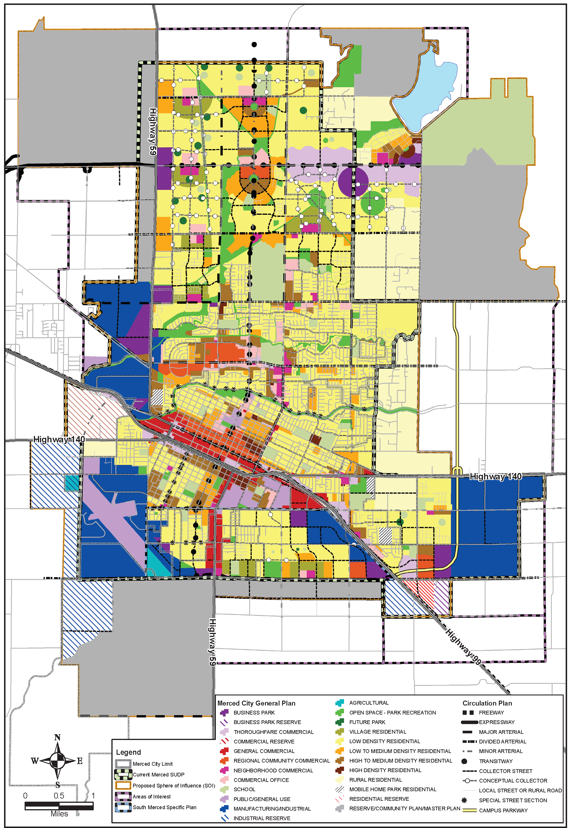
Possible Neighborhoods / Communities

Slide 8
Annexations?
If the boundaries of a city expand by the addition of new territory, including through annexation of unincorporated territory or consolidation with another city, the council shall add that new territory to the nearest existing council district without changing the boundaries of other council district boundaries.
Council may adopt new boundaries for each council district under the circumstances described above if both of the following conditions are met:
There are more than four years until the council is next required to redistrict.
The population of the new territory being annexed or consolidated is greater than 25 percent of the city’s population as determined by the most recent federal decennial census.
Does not apply to a charter city that has adopted, by ordinance or in its city charter, a different standard for adding new territory to existing council districts.
Elections Code 21623

Slide 9
Public Mapping and Map Review Tools
Different tools for different purposes
Different tools for different levels of technical skill and interest
Simple “review draft maps” tool
Easy-to-use “Draw your neighborhood” tool
Paper- and Excel-based simple “Draw a draft map” tools
Powerful, data-rich “Draw a draft map” tool
Whether you use the powerful (but complicated) online mapping tool, Excel, the paper kit, or just draw on a napkin, we welcome your maps!

Slide 10
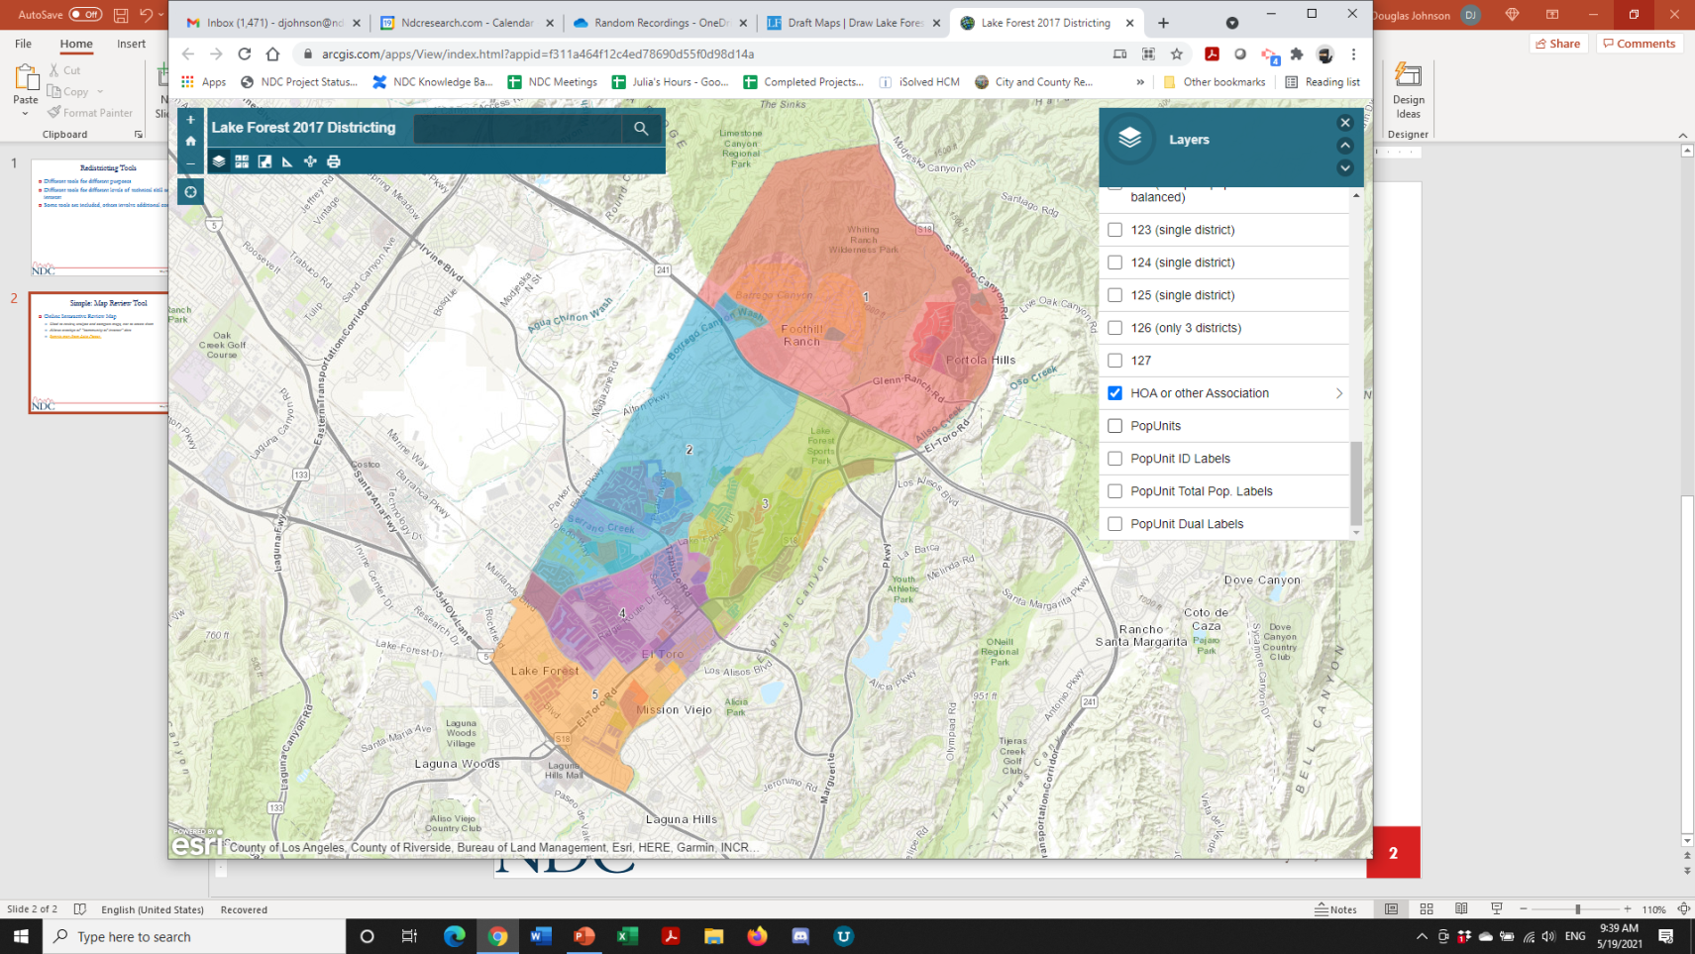
Simple Map Review Tool
Online Interactive Review Map
ESRI’s “ArcGIS Online” – similar to Google Maps in ease of use
Used to review, analyze and compare maps, not to create them
Includes overlays of “community of interest” and other data

Slide 11
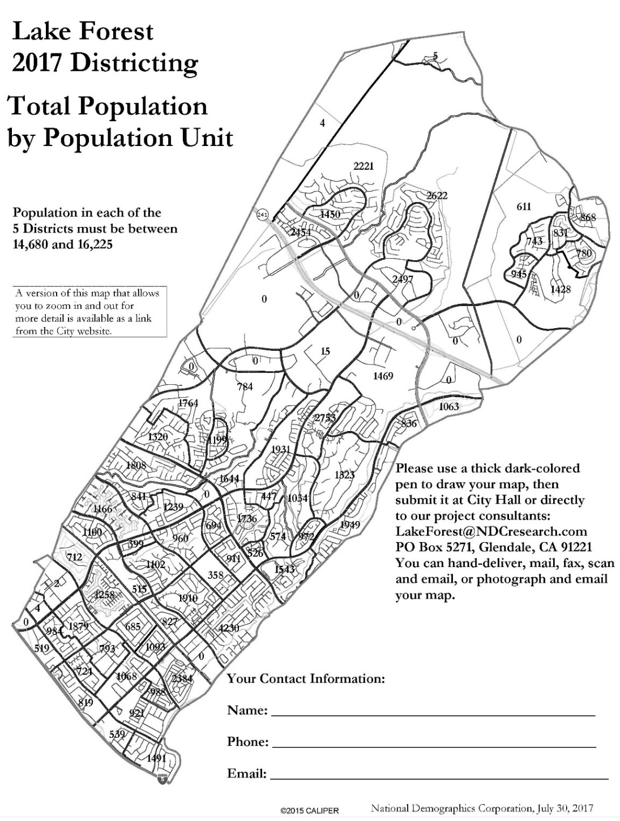
Simple Map Drawing Tool
Paper “Public Participation Kit”
For those without internet access or who prefer paper
Total Population Counts only – no demographic numbers

Slide 12
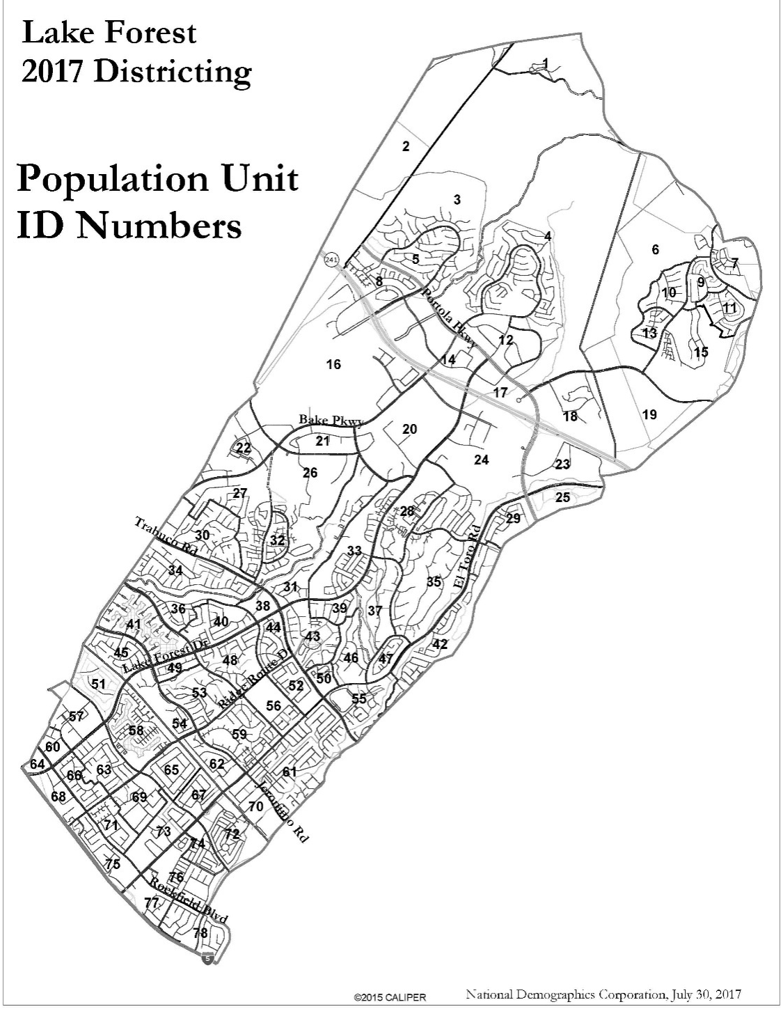
Simple Map Drawing Tool + Excel Supplement
“Public Participation Kit”
For those who know Excel and do not wish to use online tools
Adds CVAP data
Excel does the math

Slide 13
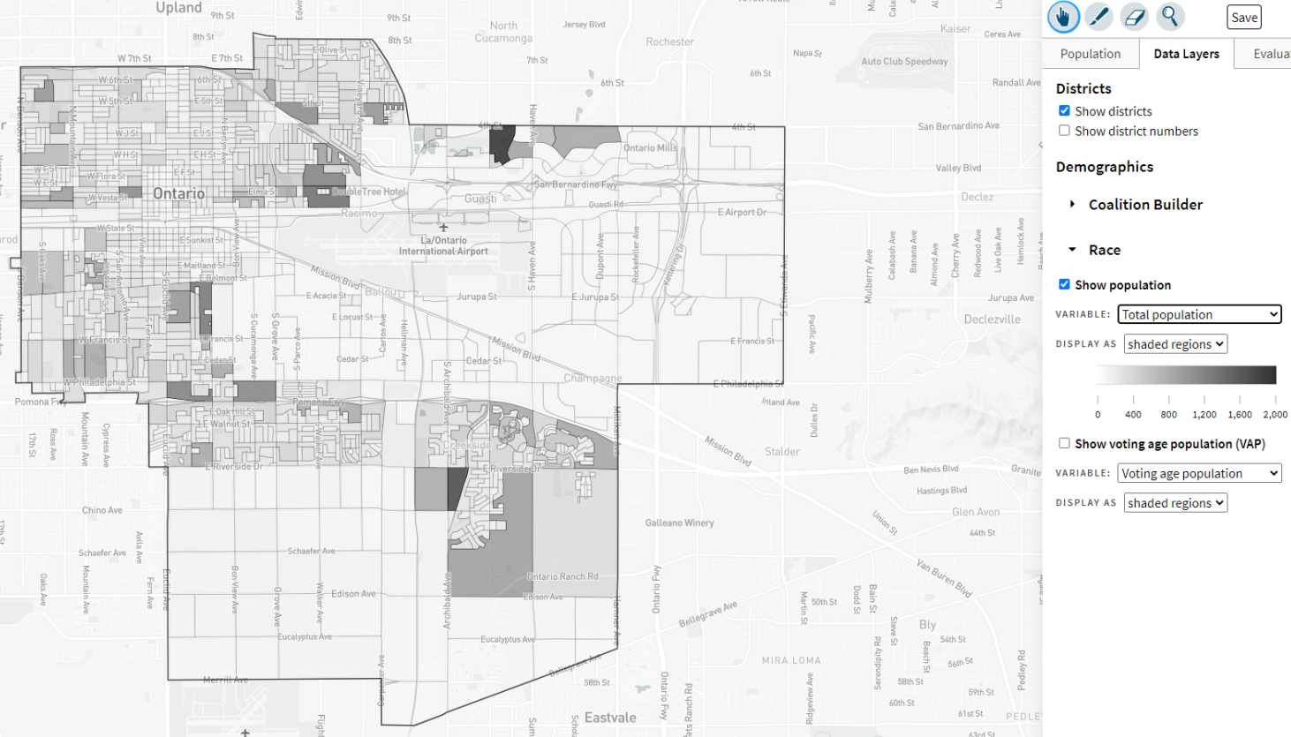
DistrictR
“Draw Your Community of Interest” focus
www.DistrictR.org
Also includes simple district-mapping tool; Only available in English
Similar external options: Representable.org, DrawMyCACommunity.org

Slide 14
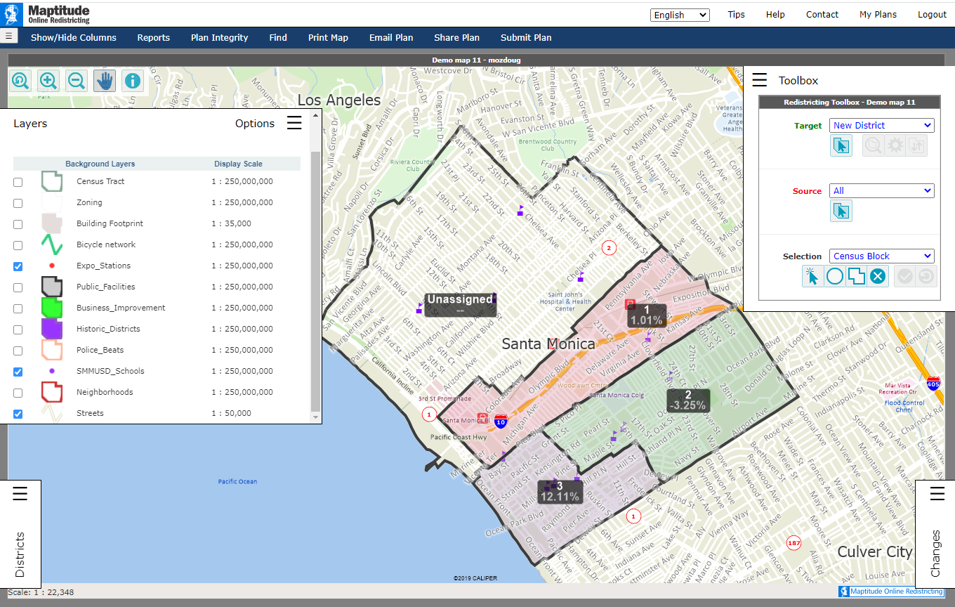
Caliper’s “Maptitude Online Redistricting”
Full Database, Powerful Online Mapping Tool
Powerful, common, data-rich online tool
Six language options: English, Spanish, Portuguese, Vietnamese, Mandarin and Korean

Slide 15
Your own mapping software?
Feel free to submit using your own mapping software:
A GIS Shapefile and/or a Census Block equivalency file (w/2020 Census Blocks);
A description of the choices and key points of your map; and,
Send to the jurisdiction’s listed districting/redistricting email address

Slide 16
Stay connected
www.cityofmerced.org/redistricting
209.388.8650 | cityclerk@cityofmerced.org

Slide 17
Public Hearing & Discussion
What is your neighborhood and what are its boundaries?
What other notable areas are in the City, and what are their boundaries?
Any questions about the mapping tools?
Discussion on:
“neighborhoods”
“communities of interest . . . that should be included within a single district for purposes of its effective and fair representation.”

